Slide 1
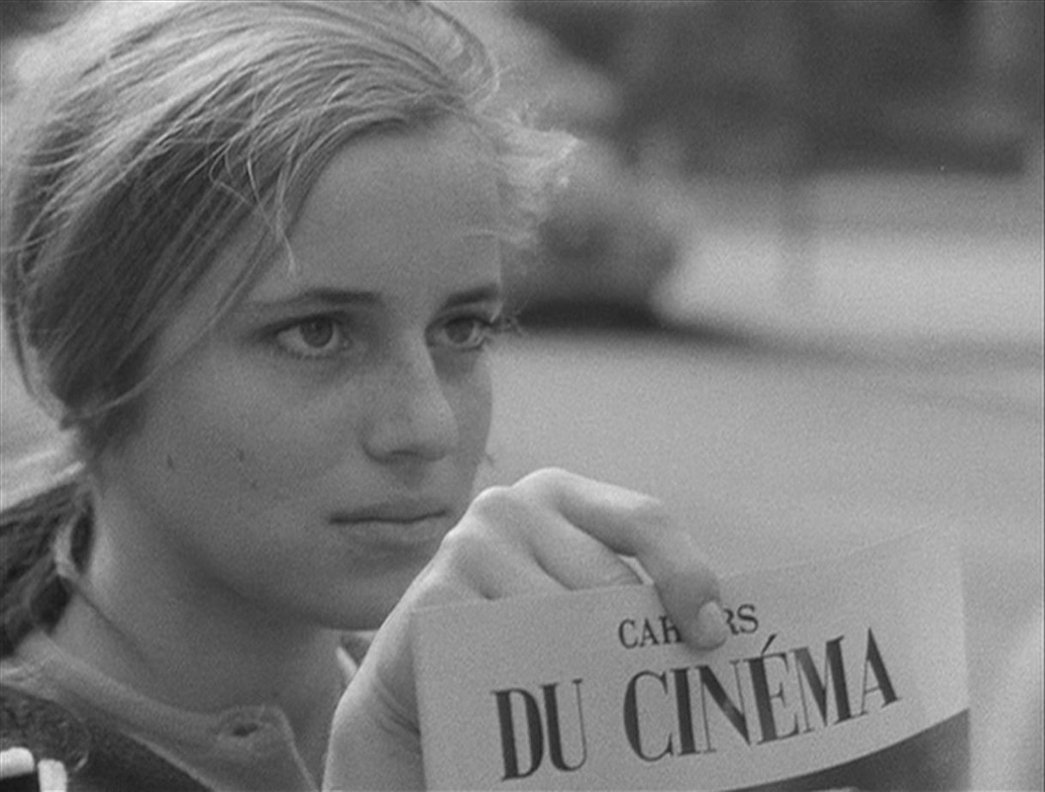
What is your association with French cinema?
Tuesday, January 3, 2017: What slowed down French cinema?

Slide 2
To Do List
Prayer
Predisposition with France!
Review Avant-Garde
The First French Avant Garde Movement: Impressionism –Louis Delluc and Abel Gance
The Second French Avant Garde Movement: Cinema Pur (Pure Cinema)
HOMEWORK: Read pp. 101-113 + Notes

Slide 3
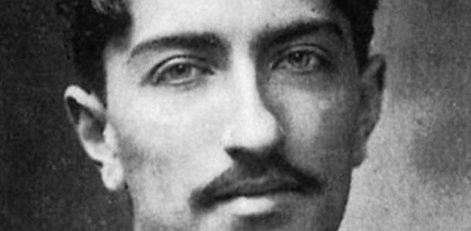
Louis Delluc –Started the “Impressionist Movement”
Impressionists: Applauded American and Swedish film styles / Disliked German Expressionists

Slide 4
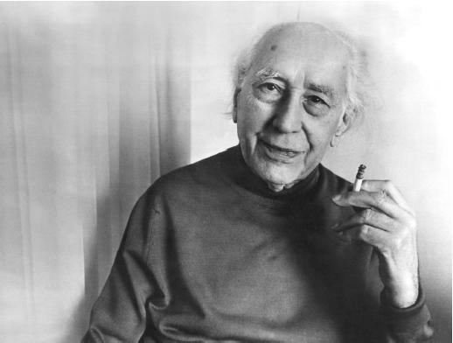
Photogenie –any subject (person, object, soul) whose moral character is enhanced through being filmed. The actual world is transformed by a camera through lighting, framing, etc.
Enhancement of the natural world (explains dislike of German expressionism
Delluc creates cine’ club –a group of likeminded filmmakers to build support for films he valued
Encouraged stylization and experimentation
Attacked current French philosophies of mimicking other styles or simply filmed theatre
Cinematographie – “using film to render interior states rather than the external world
Abel Gance – most prolific member of the French impressionists
Worked for so long that he is actually part of many movements
Most famous work Napoleon –used POLYVISION (a wrap around film technique)

Slide 5
Polyvision –three separate screens creates panoramic effect.

Slide 6
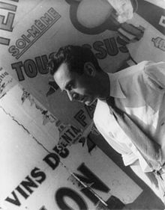
The Second Avant-Garde Movement –Cinema pur / Pure Cinema
Think of this like a lyric poem. It does not have a story and it isn’t meant to have a story.
Many of the cinema pur films were short and simply conveyed an emotion or an experience.
Because film started attracting intellectuals, it became known in France as the seventh art. (Remind me to explain cheapness…)
SURREALISM: Inspired by the works of Sigmund Freud, Marcel Proust, and James Joyce
The French thought that the use of film would be translate out the dream state
Most famous of these movies was Un Chien andalou –made by Salvador Dali and Luis Bunuel (This is the famous “eye cutting” shot we’ve seen over and over again
Un Chien andalou is considered to be “antinarrative” rather than “nonnarrative”. The structure is meant to be intentionally confusing. Intertitles seem to contradict anything that is going on screen. There is no spatial or temporal logic.

Slide 7
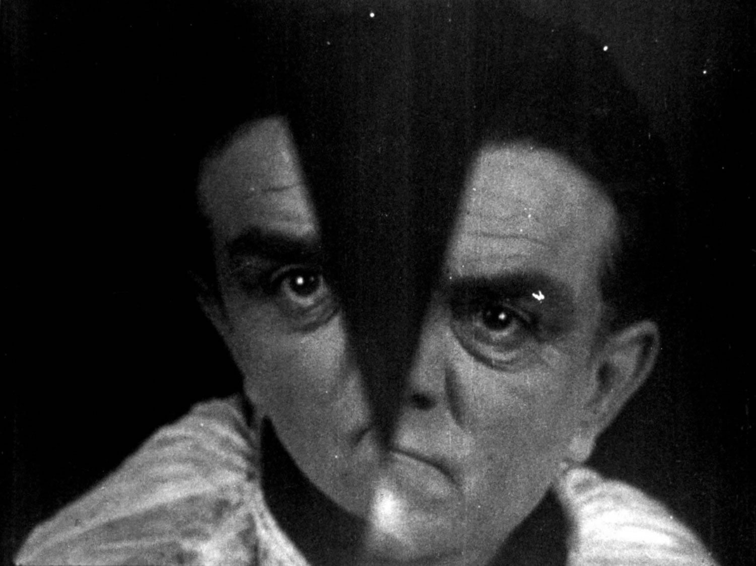
Take a guess. What killed surrealism at the end of the 1920s?

Slide 8
To Do List
Prayer
Discuss the death of surrealism
Check notes
The use of sound in France (1930s)
Innovators in sound
The Golden Age of French Cinema
Talk about Acting / Actors

Slide 9
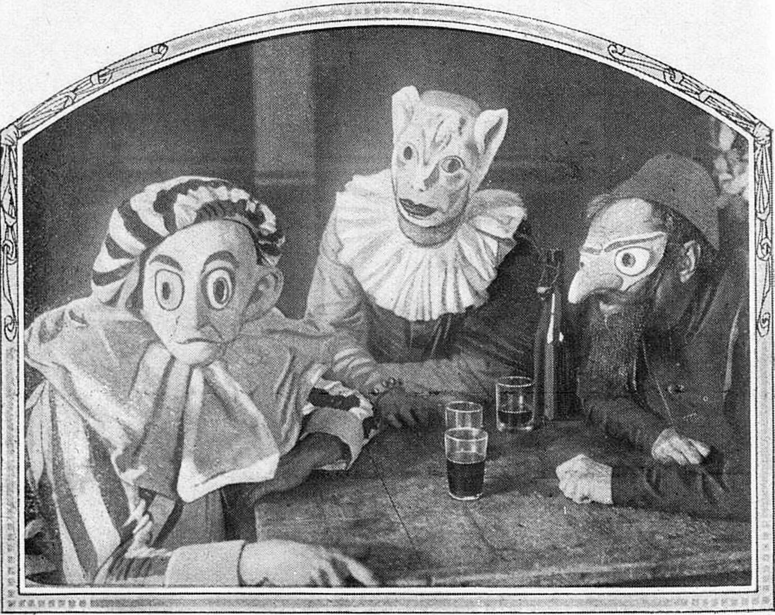
France’s lack of technology and innovation made it easier to transition to sound
Theaters needed refurbishing anyway
Only two major film studios; both doing poorly
Era of experimentation

Slide 10
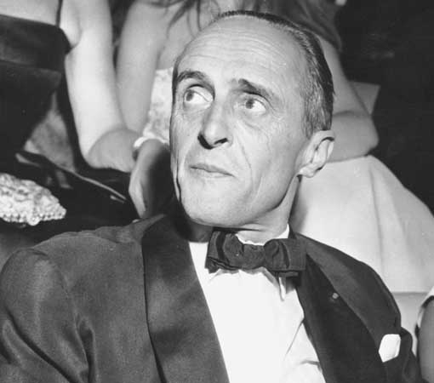
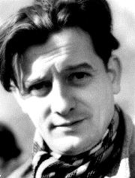
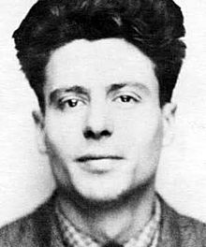
Rene Clair – Used music and noises creatively; expanded range of what sound effects could be used for.
Sous les toits de Paris (1930) https://www.youtube.com/watch?v=zf4wUmBM6gk
Marcel Pagnol – Focused heavily on dialogue. Often criticized for being overly theatrical v. film heavy
https://www.youtube.com/watch?v=X863raSxOPM
Jean Vigo –Understood that sound and silence were both effective. Adding sound to an already rich tapestry is more effective than relying on sound to carry the story.
https://www.youtube.com/watch?v=GaY-fG3zlp8

Slide 11
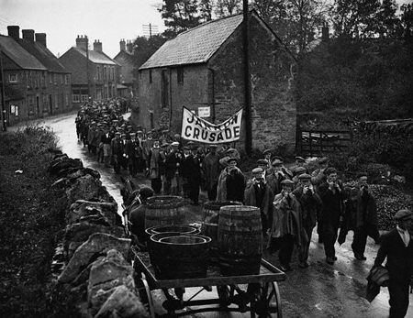

Slide 12
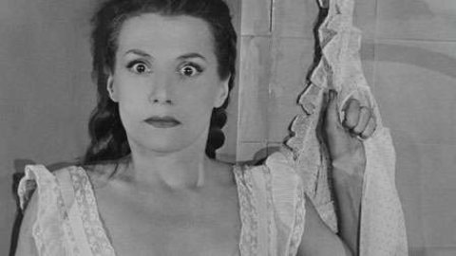
The Golden Age of French Cinema
No one is really sure what brought French cinema out of the Great Depression, but there are reasons why it succeeded.
Dialogue adds subtlety and deeper content
Emphasized intellectual content
Intelligent screenplays
Superior screen acting
Former surrealists turn film away from theatrical roots
Literary background
Birth of Poetic realism –working class protagonists dealing with a dark universe
Names to know: Marcel Carne and Jean Renoir

