Slide 1
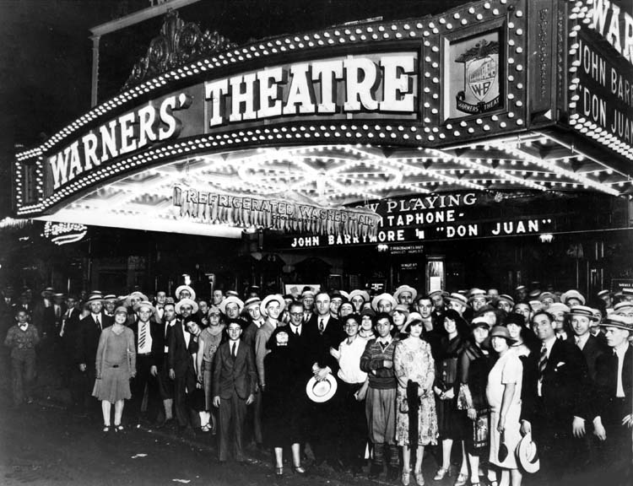
Take a guess.
Approximately how many movies were released per year by 1927?

Slide 2
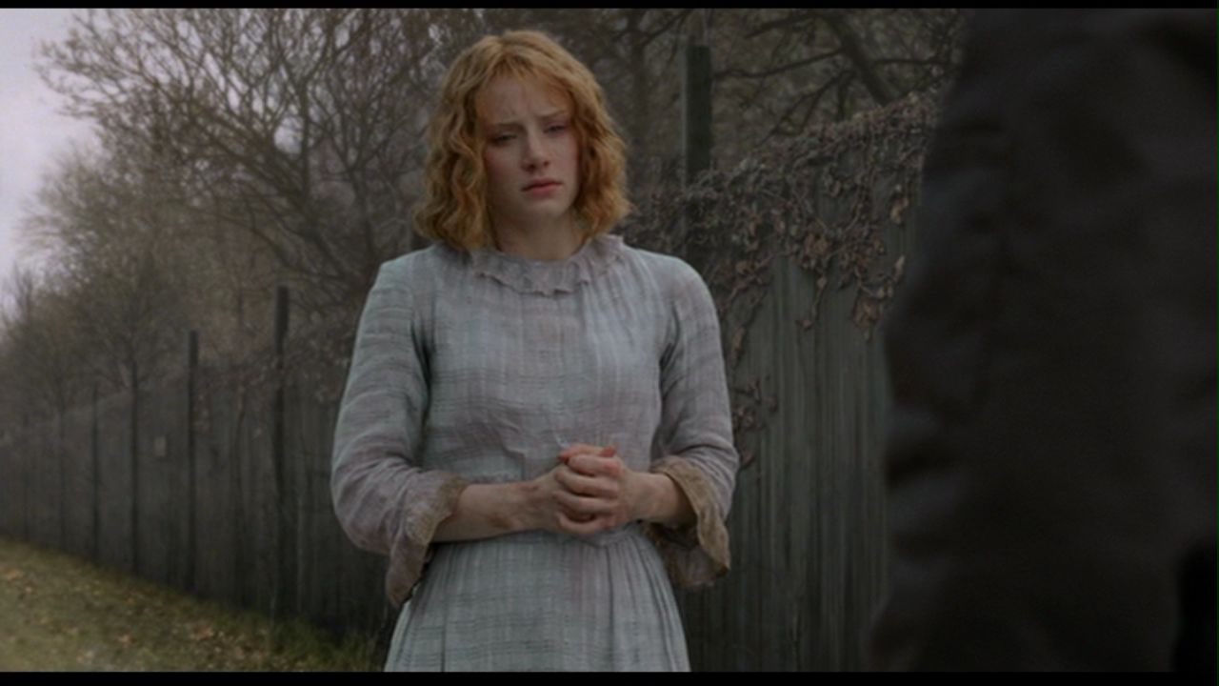
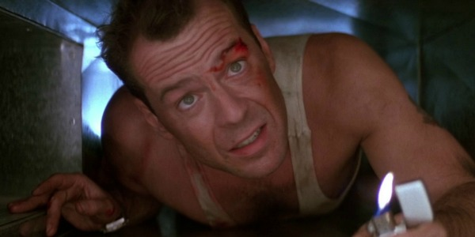
Clarity –Viewers should not be confused about setting, time, events, or character motivations
Die Hard –Nakatomi Tower (LA), Christmas, a Christmas Party, John wants to get his wife, Holly, back after a nasty breakup. (When terrorists attack, he fights the terrorists.)
The Village –The entire story is subverted by the vagueness of the setting. There is something unknown out in the woods.

Slide 3
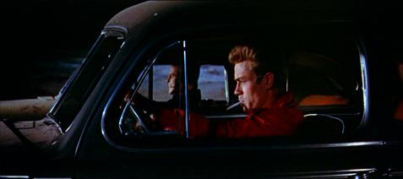
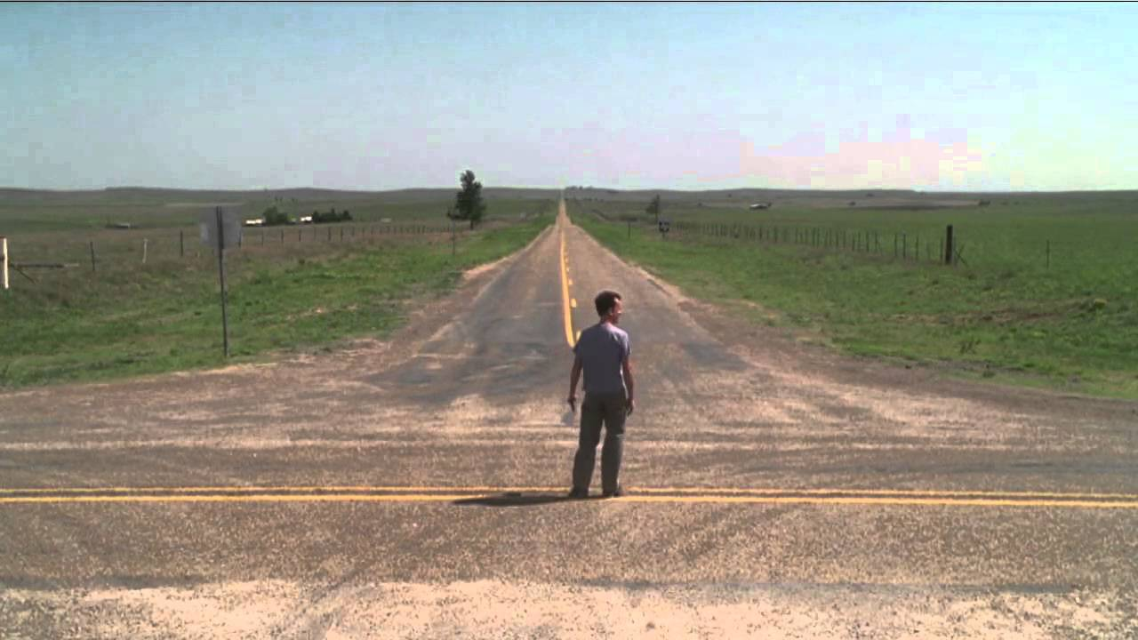
Unity –Connections between cause and effect must be direct and complete.
Rebel Without a Cause –Jim’s participation in a “Chickie Run” causes another character to die.
Cast Away –We are unsure what Chuck will choose to do by appearing at the mailbox.

Slide 4
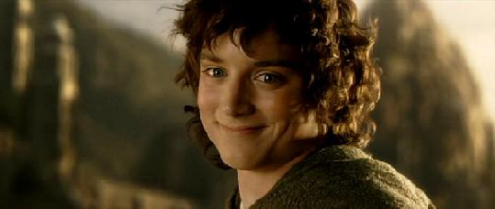
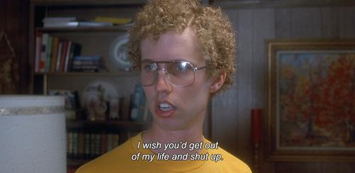
Characters –They should invite viewer identification, be active, and seek goals
The Lord of the Rings –Although Frodo is a mythical creature, his primary traits are friendliness and possessing a strong moral compass. He wishes to destroy the one ring.
Napoleon Dynamite –His appeal is due to his odd personality. He has few goals except for general coolness.

Slide 5
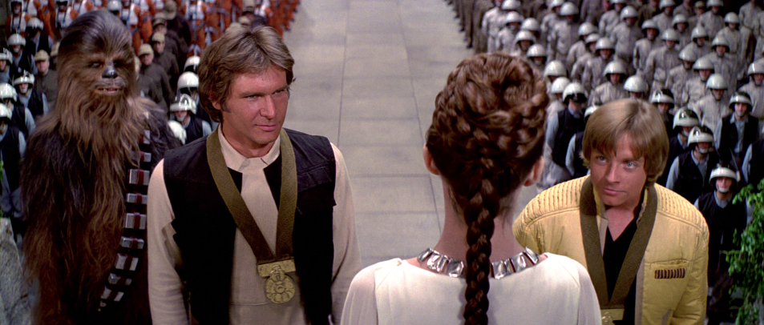
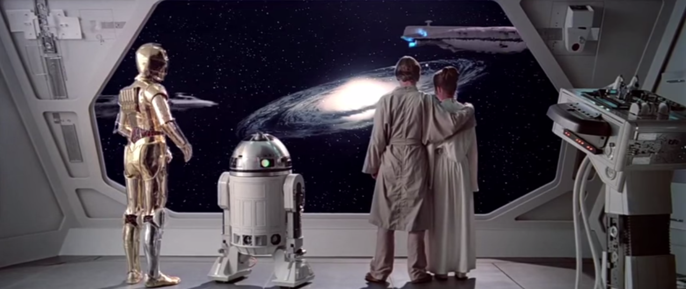
Closure –Third acts and epilogues should tie up loose ends and answer all questions
Star Wars: A New Hope –Luke Skywalker saves Yavin from the Death Star by finally learning to use the Force. He along with his band of rebels are celebrated at a ceremony due to the defeat of Darth Vader. Han Solo learns the importance of the greater good. Princess Leia is saved. R2-D2 has been repaired.
Star Wars: The Empire Strikes Back –Luke Skywalker is injured and unsure if Darth Vader is his father. Han Solo is missing and Leia has developed a mysterious new ability.

Slide 6
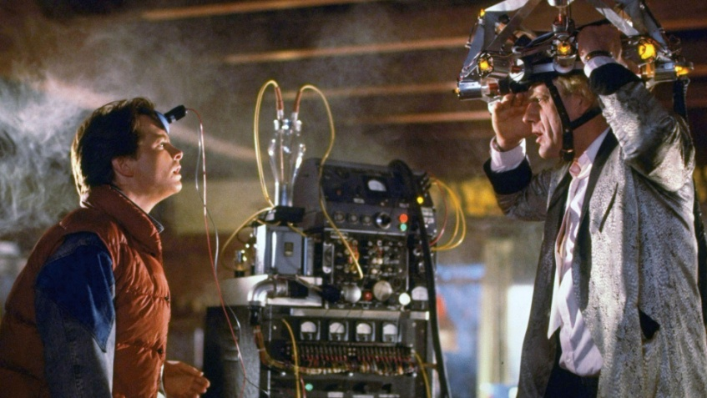
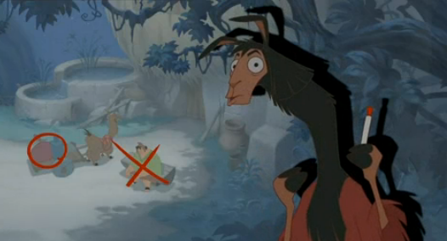
Unobtrustive craftsmanship –Stories are told in a manner that draws viewers into the diegesis and does not call attention to the storytelling process.
Back to the Future –As bizarre as the concept is, the audience quickly understands the rules of the movie and genuinely feel for Doc and Marty.
The Emperor’s New Groove –Kuzko often breaks the fourth wall and addresses the audience.

Slide 7
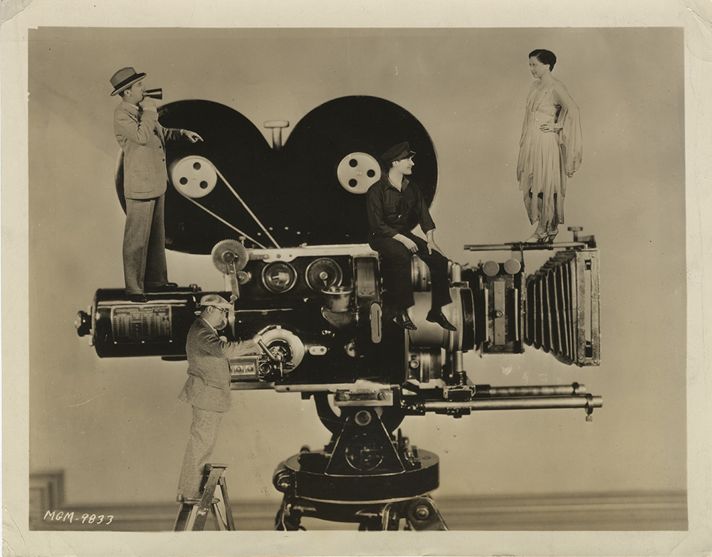
What has changed in Hollywood?
Independent studios put out of business
400-500 movies per year
Movies become big business
Attempt at vertical control –few huge firms produced, distributed, and exhibited their own films (film companies owned movie theaters). Eventually declared illegal.
80 million customers a week
Most money came from B-Movies –low budget, high return
Because major studios owned the movie theatres, they refused to distribute independent films. So if you wanted to see a Universal movie, you went to a Universal movie “palace”

Slide 8
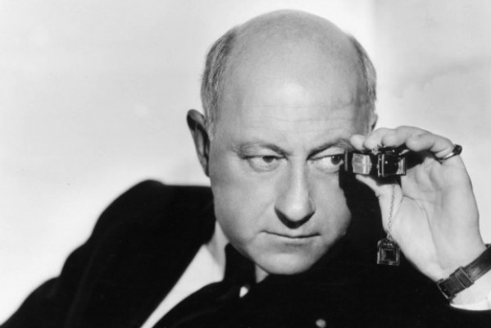
The Role of the Director
Directors considered part of a larger production line, initially lose power
Cecil B. DeMille –understood the importance of the director had to come from adapting with the times.
The reason that D.W. Griffith put his name or initials on each intertitle was to stress the importance of the director.

Slide 9
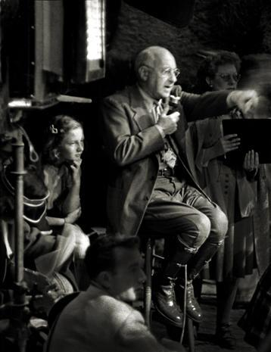
DeMille, cont’d.
Films often thought heartless
Innovated light and editing
Attached his name to biblical epics The Ten Commandments (1923) and The King of Kings (1927), which were impressive due to attention of detail
Reintroduced the importance of special effects
Brought his name to the marquee (People went to go see “DeMille” pictures)
Publicized own personality

Slide 10
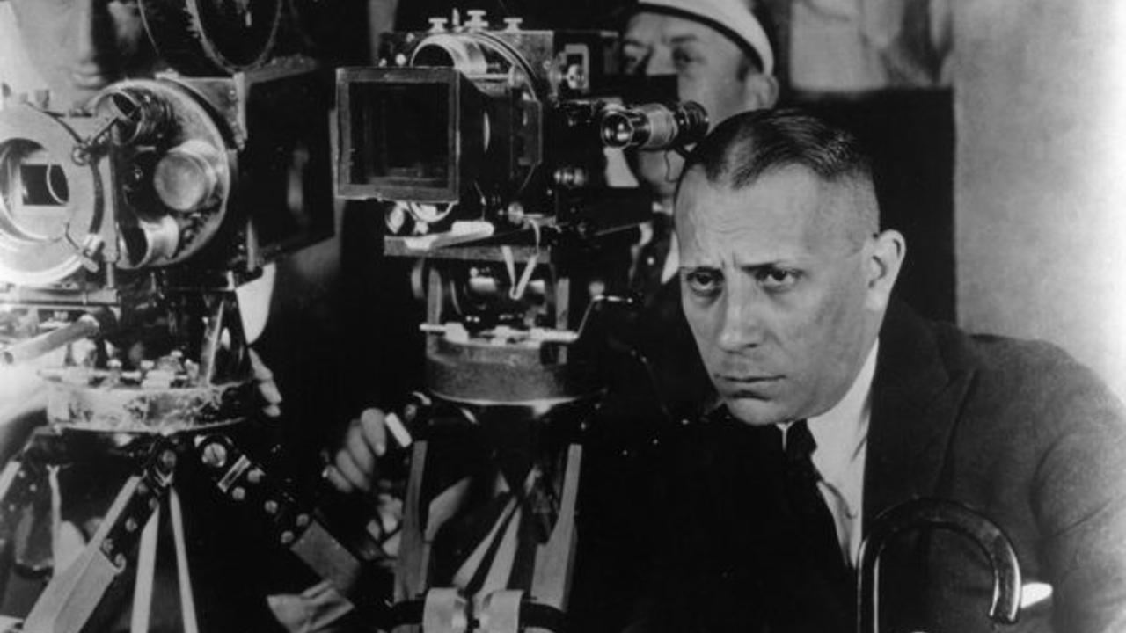
Erich von Stroheim – Used the same techniques as DeMille, but didn’t care what audiences wanted. Filmed naturalist films. Most important film: Greed

Slide 11
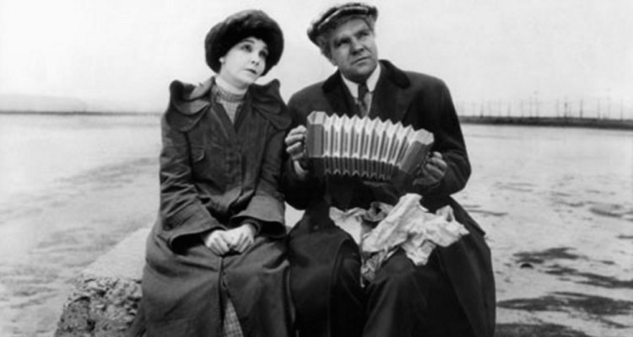
Erich von Stroheim’s philosophy: Not only show the warts of reality, but stress them.
Common motifs: venality, selfishness, money, station, power, sexuality.
Facts about Greed
Originally over seven hours long (45 reels)
Studio cut it down to approximately 1 hr 40 min
Von Stroheim disavowed the movie
It cost an ungodly amount of money
Von Stroheim went on to become and actor

Slide 12
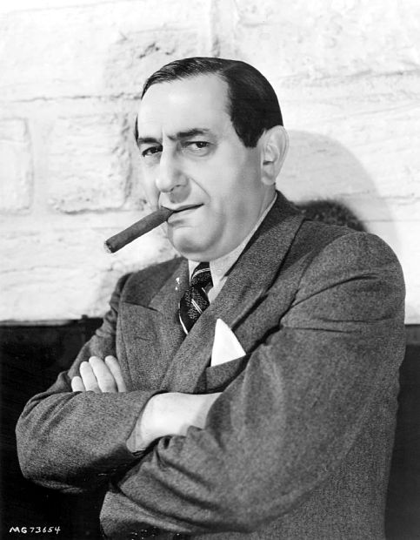
Ernst Lubitsch
Emigrated from Germany
Known for adaptation (Adaptation = success)
Attached himself to tried and true genres
Started with epics
Moved to comedies and light dramas (flips careers with DeMille
Only similarity to Erich von Stroheim is his motifs of sex and money
Sex and money used by upper class for entertainment purposes
Known for “the Lubitsch touch” (sophisticated humor)
Popular films in this era:
The Marriage Circle, Forbidden Paradise, Lady Windermere’s Fan

Slide 13
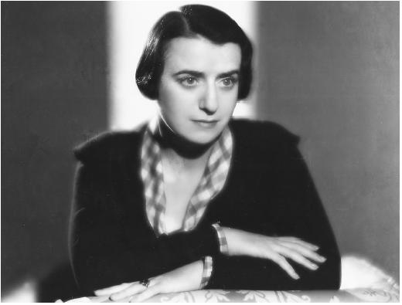
Women in Hollywood
Not a great time
Most women became screenwriters
Frances Marion (pictured) worked with Mary Pickford; became great journalist
June Mathis (discovered Rudolph Valentino) headed MGM’s script department
Elinor Glyn –coproduced It (1927); “It” became a euphemism for “sex appeal”

Slide 14
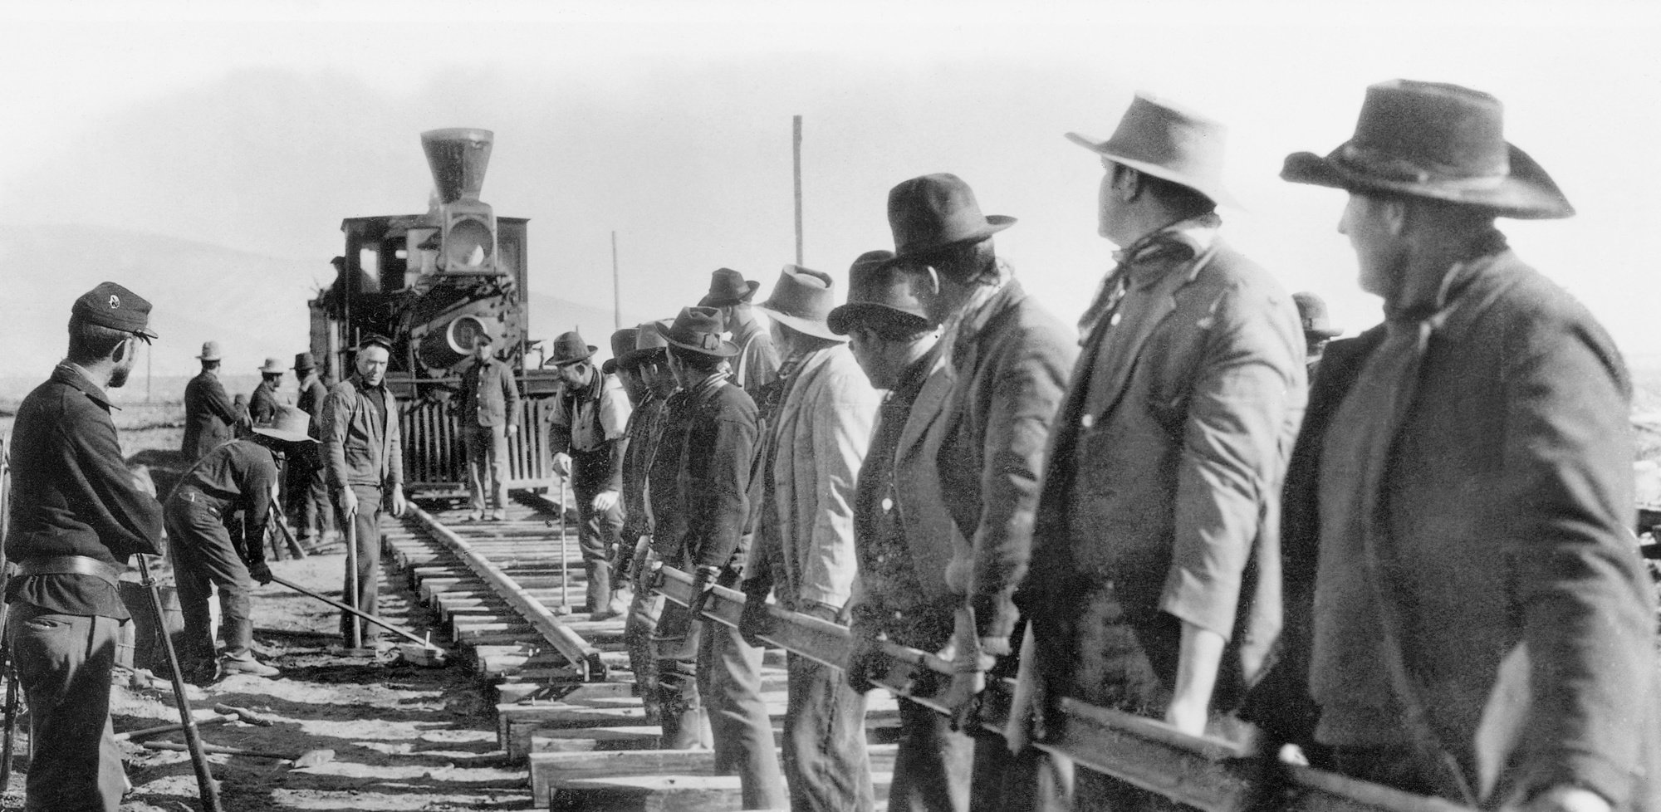
Westerns –resonated with Americans; stress on land as private property; rationalized conquest of indigenous people
Important films: The Last of the Mohicans (1920), The Covered Wagon (1923), The Iron Horse (1924), The Vanishing American (1925)
Important names: John Ford (director)

Slide 15
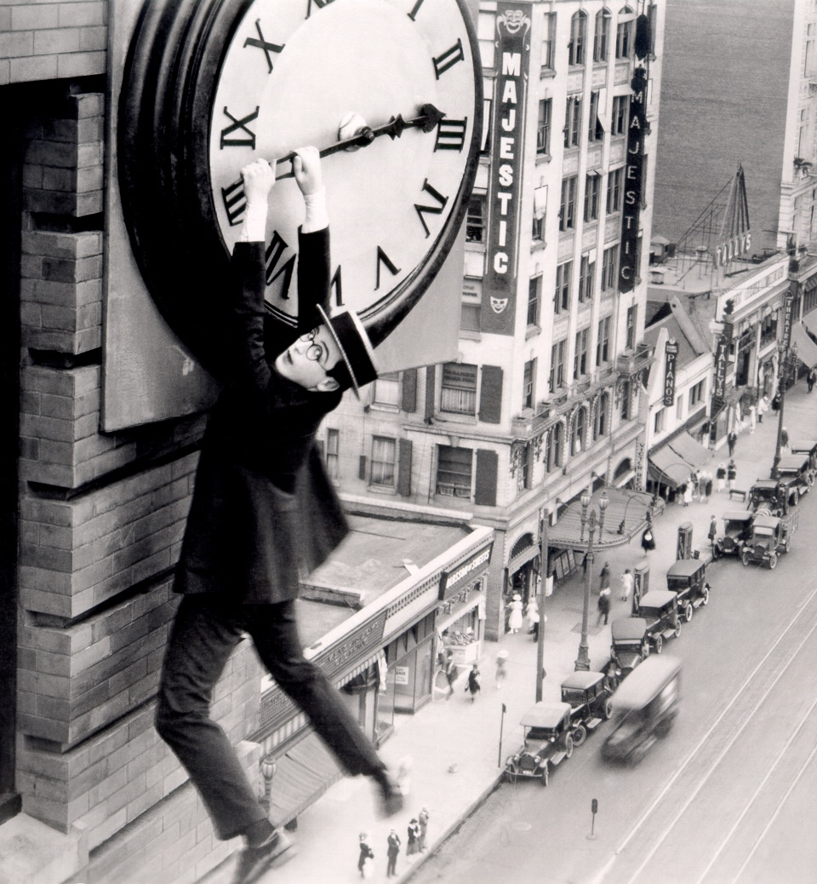
1920s – “Comedy’s Greatest Era”
Names to Know
Charlie Chaplin –The Kid (1921), The Gold Rush (1925)
Buster Keaton –The Navigator (1924), The General (1927), Sherlock, Jr. (1924)
Harold Lloyd –Safety Last (1923)
Note: The advent of sound changed the way these films were made.

Slide 16
Two War Philosophies:
War is Hell –Examples: The Big Parade, What Price Glory?
Air-War: The Long Eagle, Wings, The Legion of the Condemned
Air-War movies were verrrrrryyyyy pro-war; highly dramatic, sensational

Slide 17
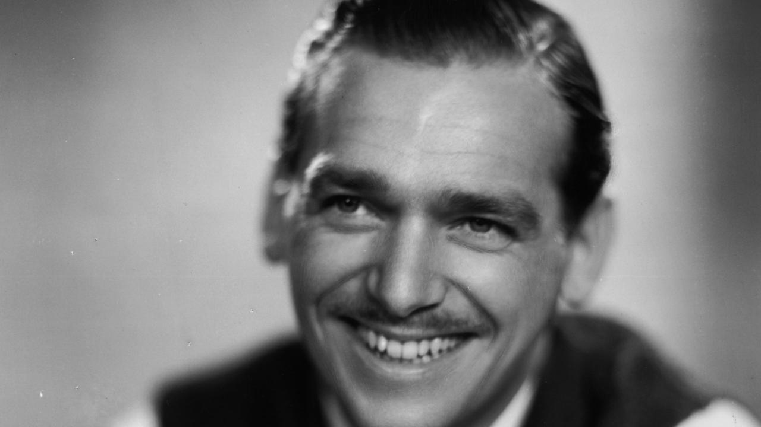
Douglas Fairbanks
Action / Adventure star
Known for performing amazing feats; ingenuity of action sequences
Movies to know: The Mark of Zorro (1920), The Three Musketeers (1921), Robin Hood (1922), The Thief of Bagdad (1924), The Black Pirate (1926)

Slide 18
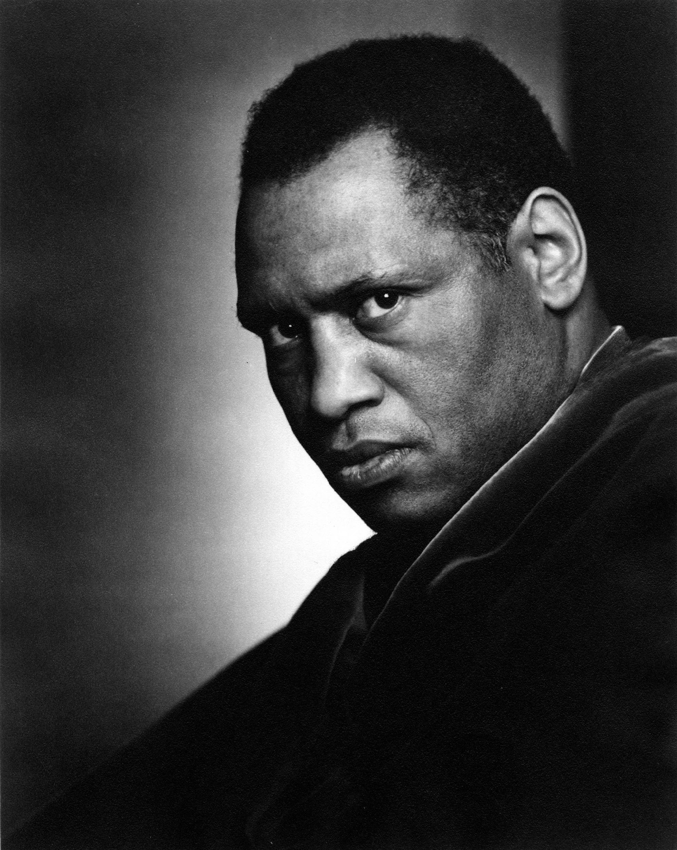
RACE MOVIES:
Response to Birth of a Nation
Films for African American audiences
Important movies
Birth of a Race
The Trouper of Troup K
Scar of Shame
OSCAR MICHEAUX: worked as distributor, actor, writer, director, producer etc. to make these films public
PAUL ROBESON: Actor and civil rights activist; famous for Showboat

Slide 19
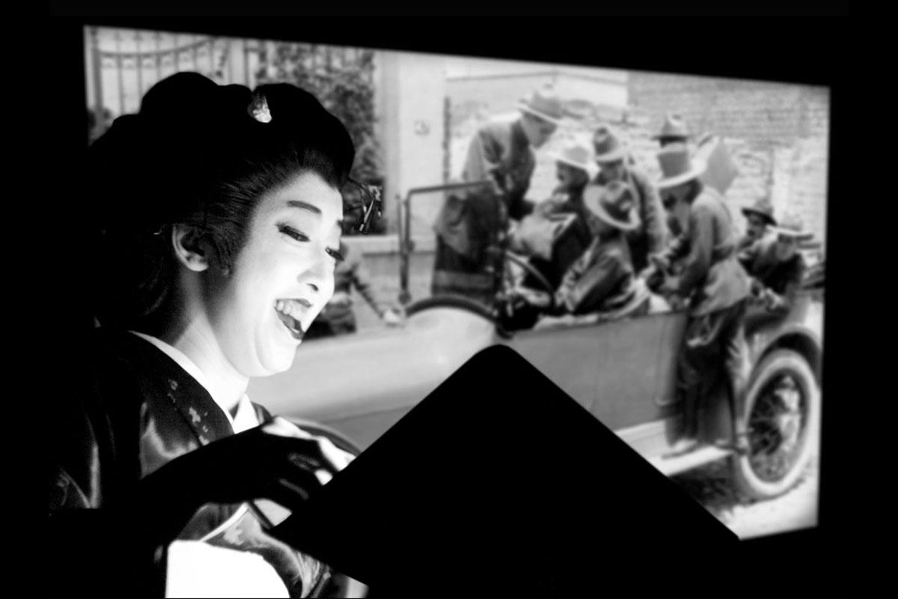
Benshi –Japanese narrators for silent film; would often “act out” movies

Slide 20
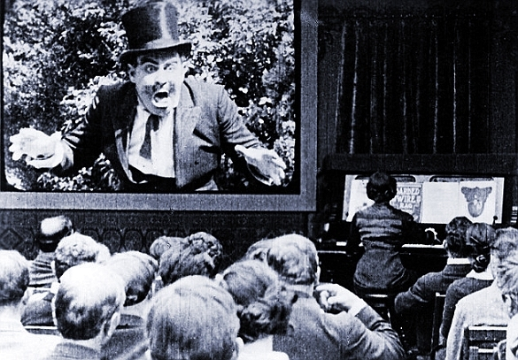
Music during Silent Film era:
Often with organist or pianist
Stock melodies often used
Certain movies came with musical scores
Often artists made up the music after not having seen the movie
Why no talkies earlier? There was no way to project the sound in open theatres until the vacuum tube was invented. Edison originally synced his movies with audio!

Slide 21
Why was sound a novelty?
Facilities had to be changed
No one wanted to pay royalties to Warner Brothers, who owned the technology after Don Juan
Technology was still super shaky
Too many silents in production
Could silent actors transition to talkies?
Audiences abroad could easily translate intertitles, but couldn’t dub sound.

Slide 22
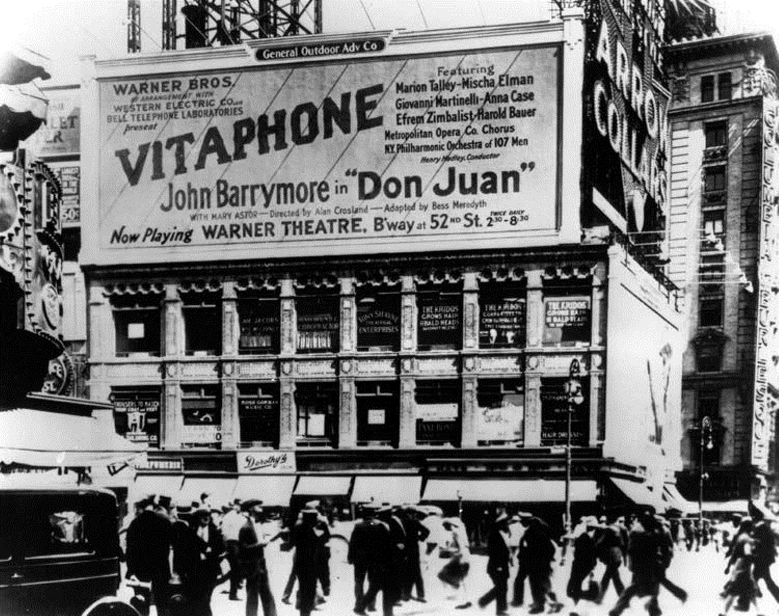
TERMS TO KNOW:
Vitaphone: Technology developed by Warner Brother to sync sound. Originally used to tie musical score with sound effects to film
Don Juan : First Vitaphone picture
The Jazz Singer: The first “Talkie” –Fourth Vitaphone picture; adapted from a stage play; starring Al Jolson

