Slide 1
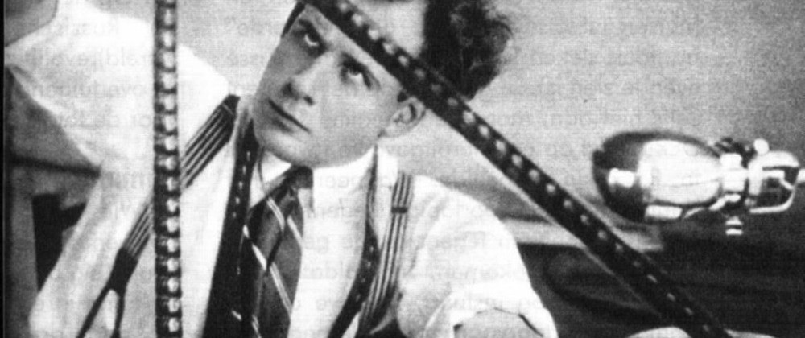
Soviet Cinema
Based on what you know about the Russian Revolution, what themes might you see in Russian cinema?

Slide 2
Germany v. Russia
Germany
Russia
No fighting within borders of Germany
Rebellion of 1919 fails
Slowness of tempo
Smaller stories
Focus on soul
Much of WWI fought in Russia
Bolshevik Revolution suceeds (1917)
Rapid pace and physical action
Epic stories
Focus on brain

Slide 3
Czar Nicholas II v. Lenin
Nicholas II
Lenin
“I consider cinematography an empty, useless, and even pernicious diversion. Only an abnormal person could place this sideshow business on a level with art.”
Few theaters
Ticket prices high
High illiteracy rates = few intertitles
“Of all the arts, the cinema is the most important for us.”
Many film producers left / emigrated along with actors and supplies
Post Revolution: worst winter on record; supplies thin; government famine

Slide 4
State Institute of Cinematography (VGIK)
Formed in 1919
Nationalized –Capitalist traditions would not work in Soviet Russia
Divided into Right and Left Wing factions (NOT political, but stylistic)

Slide 5
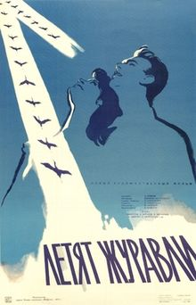
Right Wing
Started using conventional filming methods, but replaced rich actors with peasants and soldiers
Started with traditional Hollywood storylines, but moved to sociological issues
Became only state approved method after socialist realism was imposed in the 1930s

Slide 6
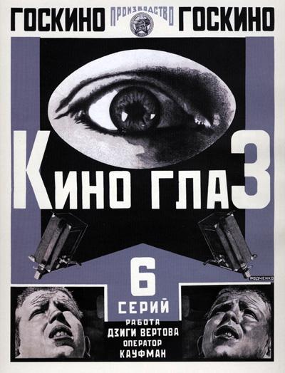
Left Wing
Radical in innovation
Dziga Vertov: started in newsreels to inform apathetic public about Revolution
Founded Kino Eye-Group; “Life caught unawares”
Filmmaker had little control to reality
Kino-Pravda: forefather to “Cinema-verite”; series of weekly newsfilms
Editing takes precedence over choosing what to film
Used scraps from other movies to edit in

Slide 7
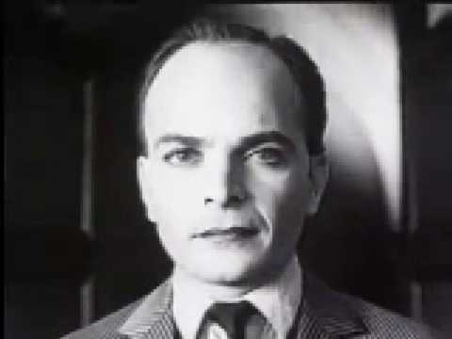
The Other Left: Lev Kuleshov
Creator of the Kuleshov Effect (juxtaposition)
Head of VGIK
Rehearsed with empty camera
Stressed importance of editing
Created great performances out of terrible actors
Please note: This is NOT Lev Kuleshov. This is a still from the Kuleshov Effect

Slide 8
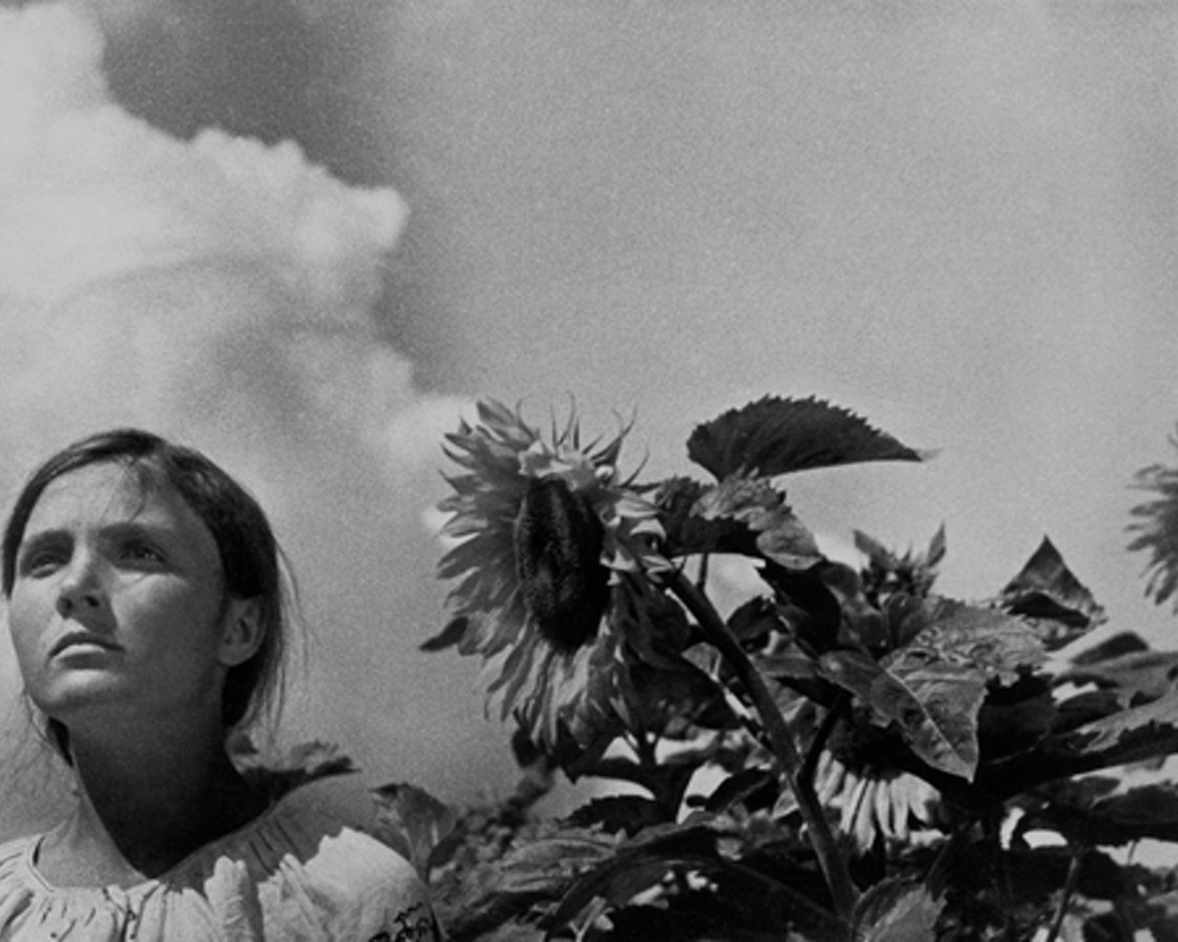
Alexander Dovzhenko
Three major works: Zvenigora (1928), Arsenal (1929), Earth (1930)
Ukrainian by birth
Focus on relationship of scenes v. shots
Poetic focus rather than narrative or dramatic
Optimistic tone – seen as “defeatist” or “counterrevolutionary”

Slide 9
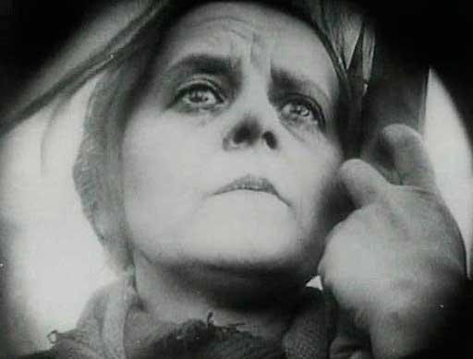
V.I. Pudovkin
Major works: Mother (1926), The End of St. Petersburg (1927), Storm over Asia (1928)
Physicist and chemist
Studied under Kuleshov
Wanted to be an actor
Focused on differences between stage acting and film acting
Film = bits and pieces form synthetic whole
Influenced by Griffith
Focus on emotions

Slide 10
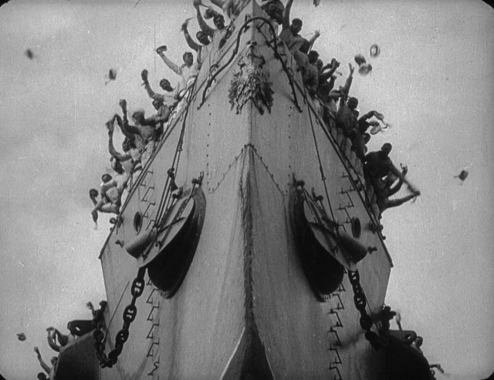
Sergei Eisenstein
Interested in Japanese language and culture; influences film style
Weeping = Eye + Water (two symbols = third symbol)
Japanese film is as visual as it is verbal
Started as a scene designer for Proletkult Theatre; learned to distrust character centered theatre and make masses the hero (social problems as opposed to romantic triangles)
Meyerhold over Stanislavsky

Slide 11
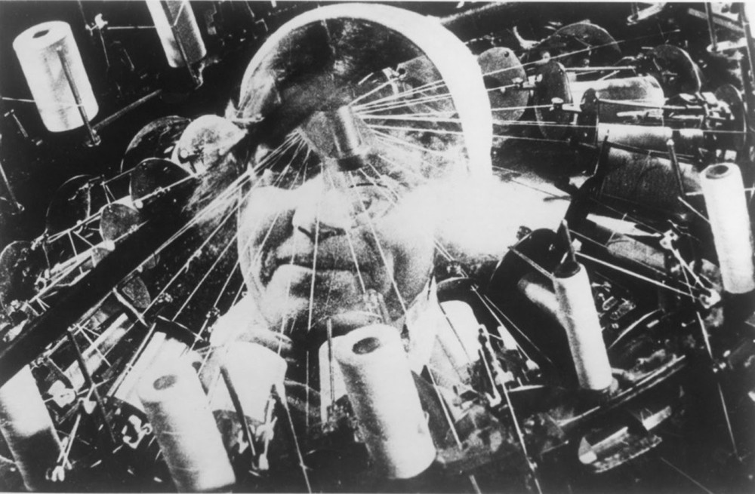
Eisenstein Continued:
Meyerhold –don’t pull from emotions; recreate them externally
MONTAGE OF ATTRACTIONS: a series of sensory experiences that would involve the spectators to carry them along a predetermined path of emotional response (Watch PBS Video here… https://www.youtube.com/watch?v=-RtBAa4YCgo)
He stole ideas from his early work with the circus here (caricatures, gross symbolism, exaggerated action)
October (1928), Alexander Nevsky (1938), Ivan the Terrible I (1944) and II (1958)

Slide 12
Russian Formalism –built on montage editing focusing on specific themes and techniques

