Slide 1
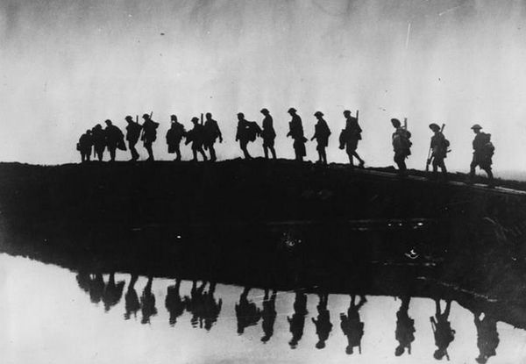
America didn’t enter WWI until very late. Take a guess how this helped American filmmakers.

Slide 2
To Do List
Prayer
Discuss World War I
The 3 big moments that made Hollywood
The fall of D.W. Griffith
Mark Sennett –slapstick
The use of the chase
Commedia dell’arte
Charlie Chaplin and the creation of United Artists

Slide 3
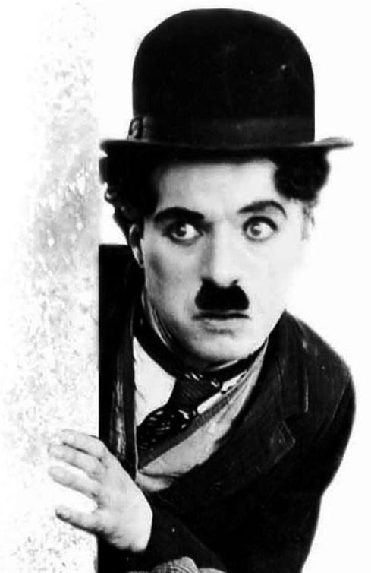
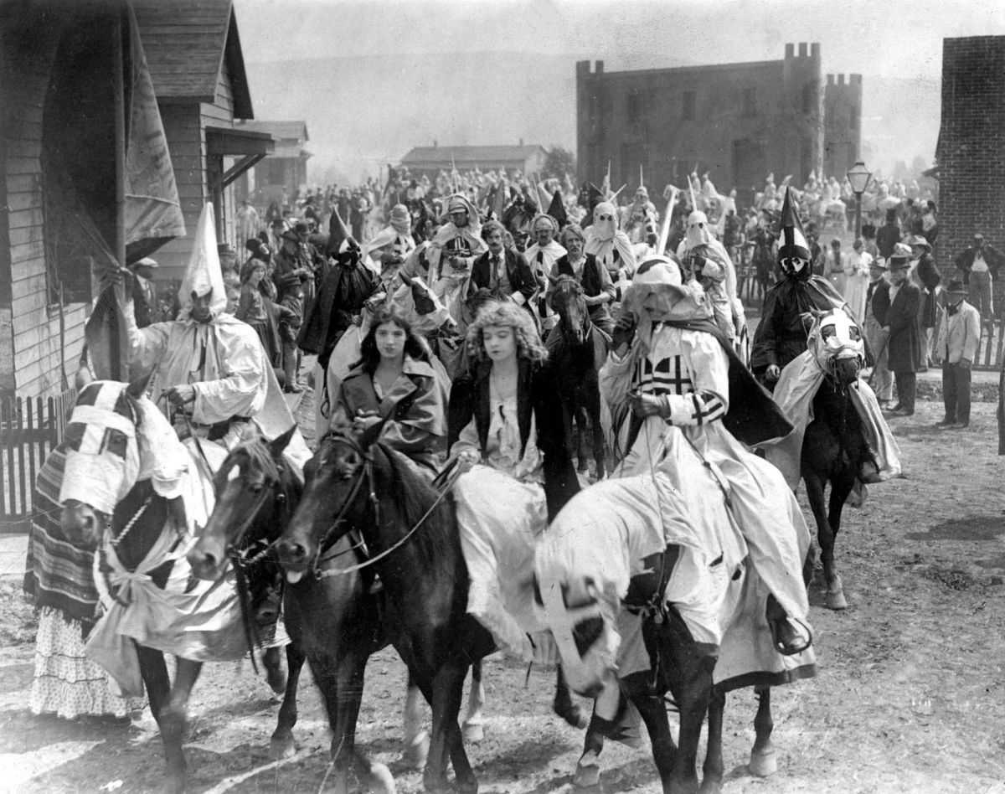
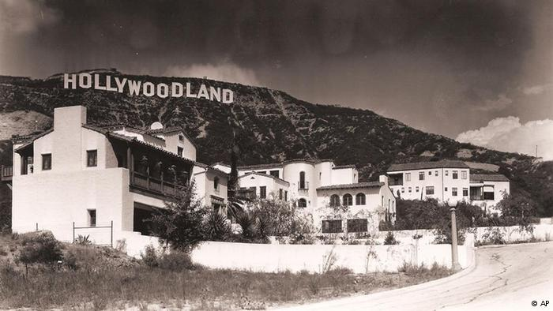
Three Major Advantages
D.W. Griffith invents the epic (large budget, sweeping score)
The slapstick comedy
Hollywood becomes a mass producer of film

Slide 4
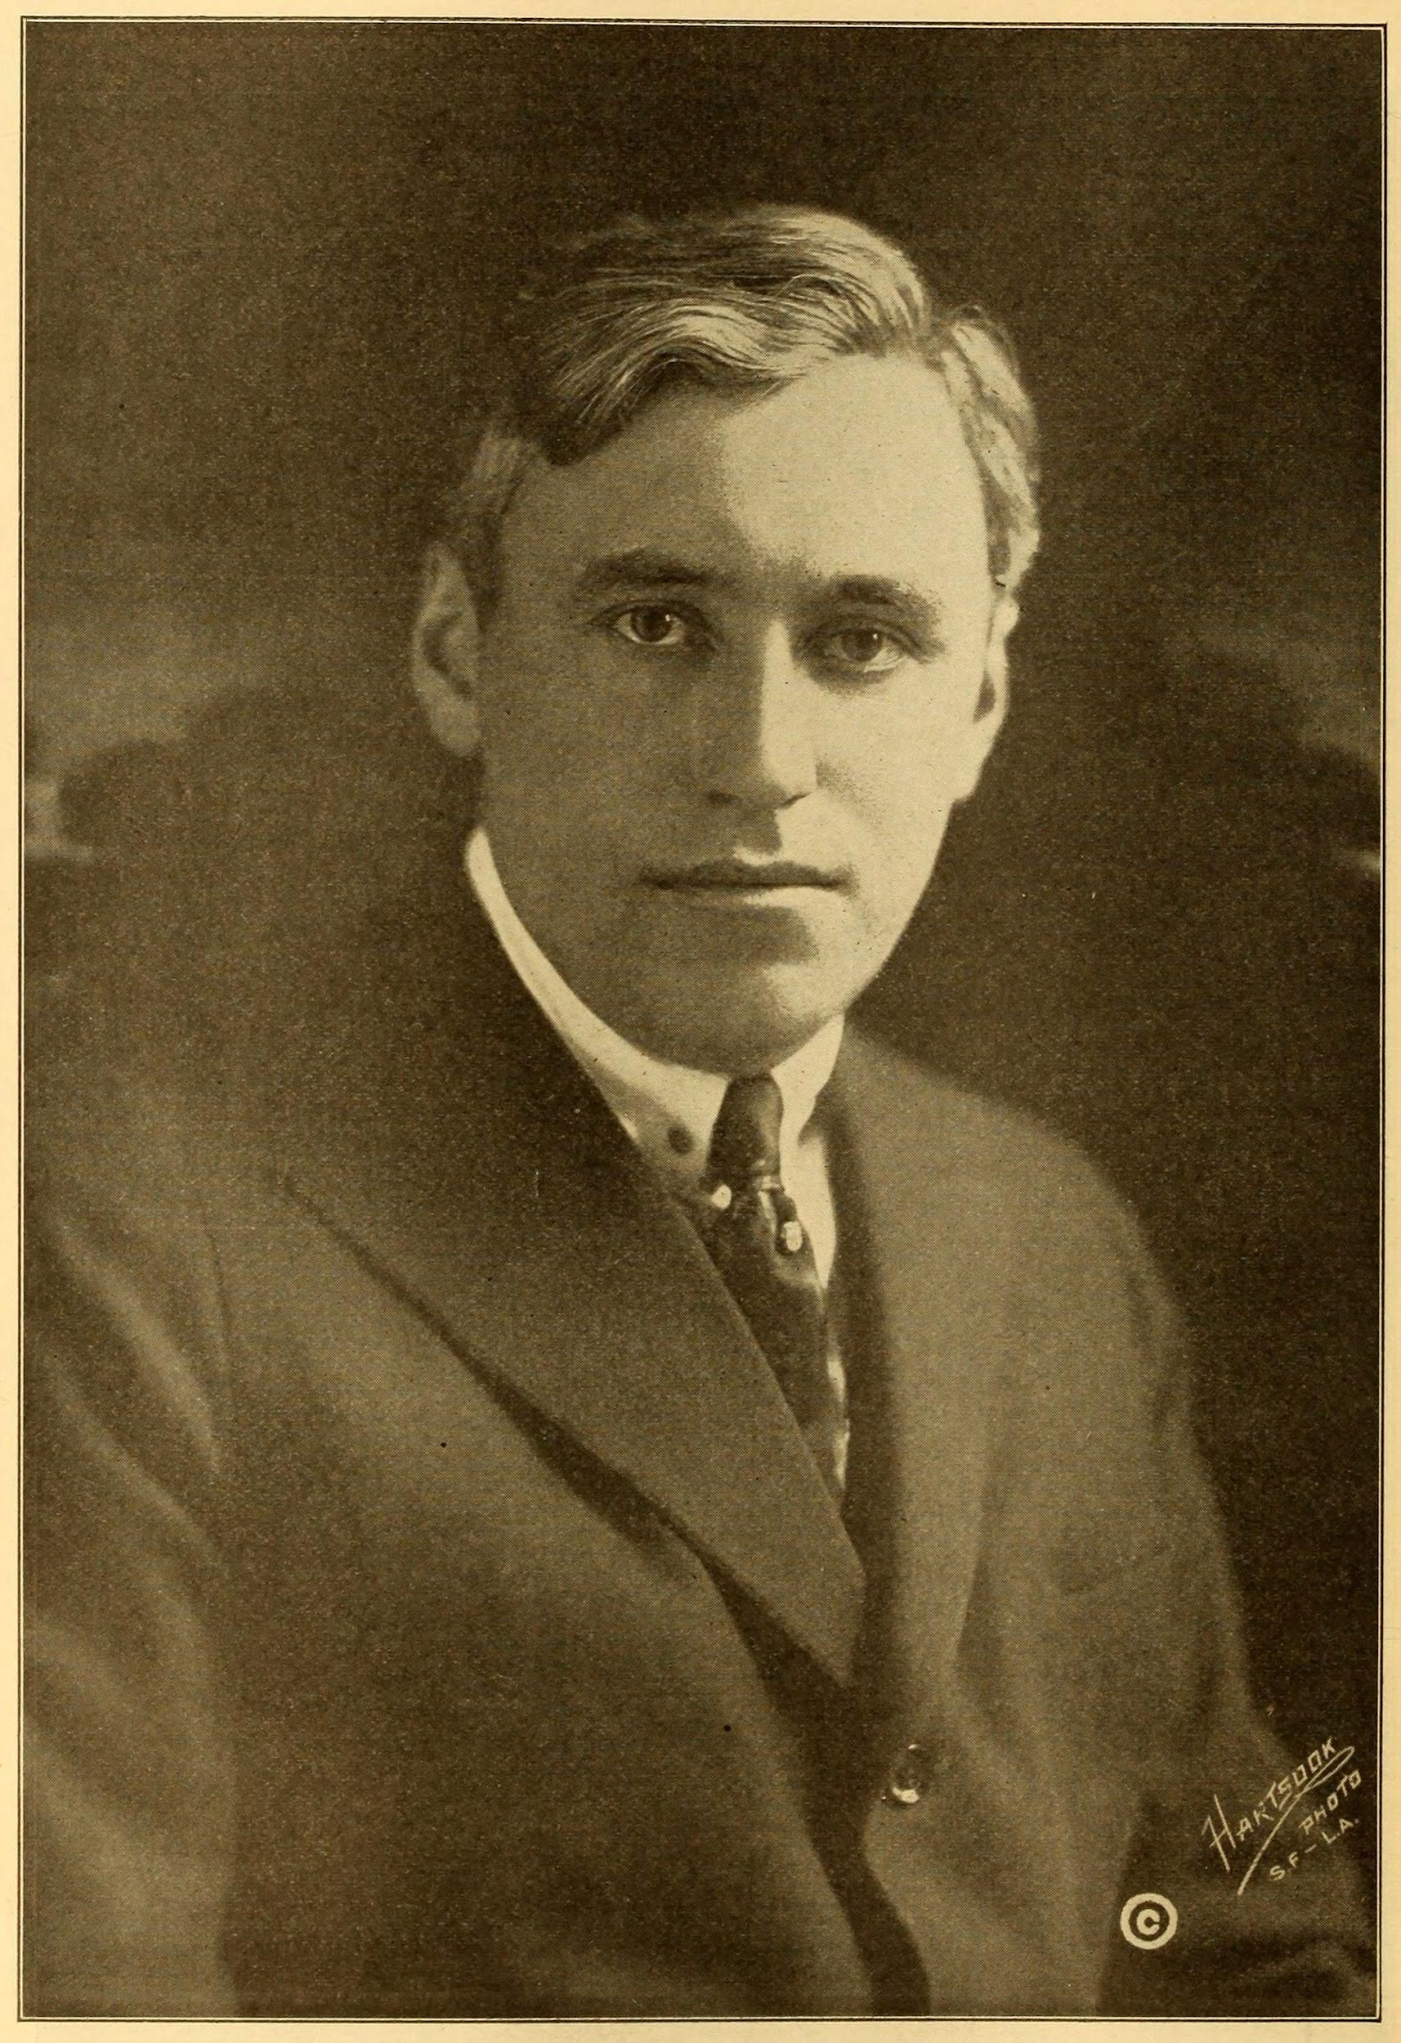
Mark Sennet
Unofficial student of Griffith
Realizes funny looking people are funny
Spearheaded a move to slapstick comedy
Uses Griffith’s techniques for chases, but emphasizes absurdity
Parody of popular films
Slapstick
Play up misfortune (looks, economics, obesity, etc.)
There is no death
Survive annihilation
Cathartic
Little guy v. institution

Slide 5
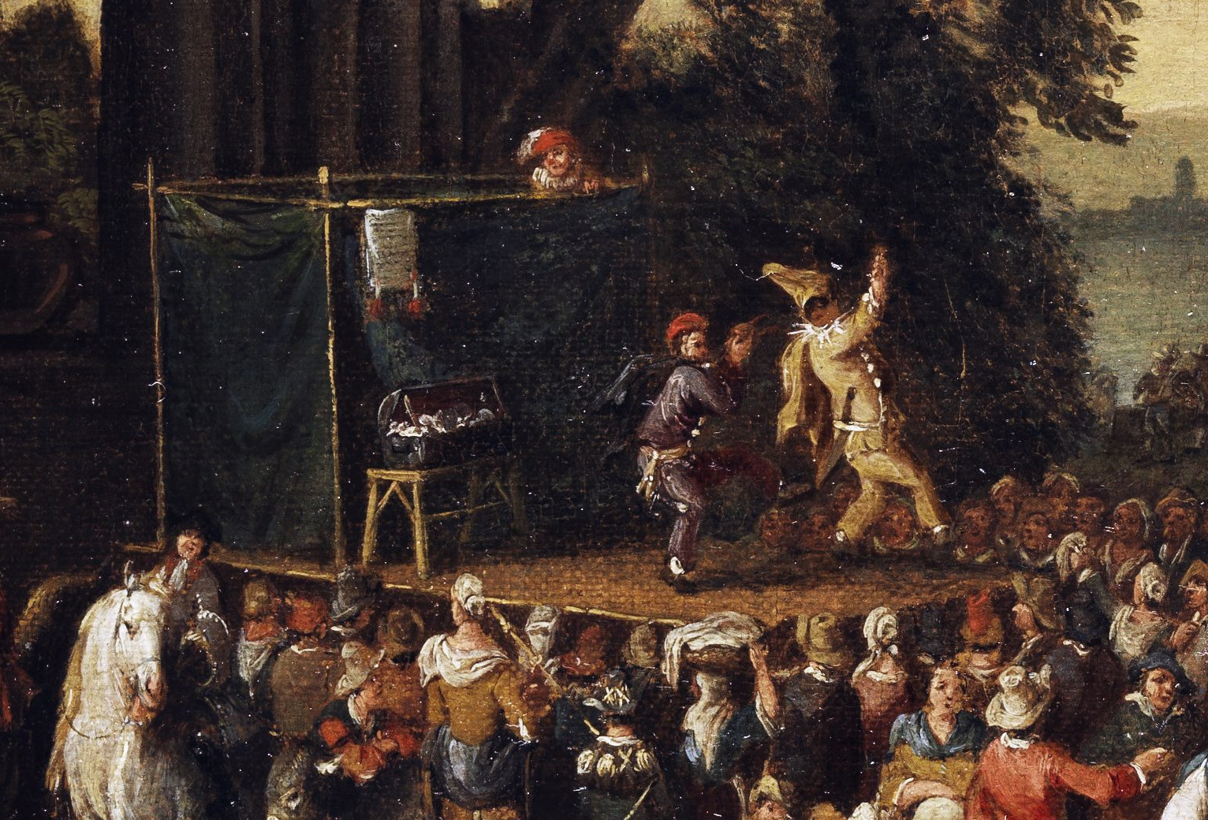
Commedia dell’arte
A mostly improvized style of comedy that would go town-to-town and perform shows. Characters were known as “stock characters”…similar to archetypes.

Slide 6
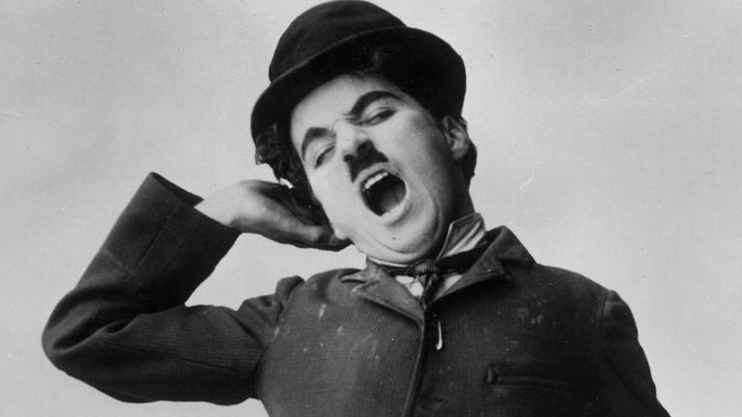
Charlie Chaplin
Creates character of the Tramp
Removes himself from “Keystone Kops”
Uses physical humor
Gains autonomy
Satires human condition
Joins with D.W. Griffith, Mary Pickford, and Douglas Fairbanks to form United Artists

Slide 7
How can credits and music affect a viewers mood?
How do they establish tone quickly?

Slide 8
To Do List
Prayer
Discuss opening credits
Diegesis v. Nondiagetic Elements
HOMEWORK: Notecards Due November 2
HOMEWORK: For Friday, find the most effective use of non-diegetic elements

Slide 9
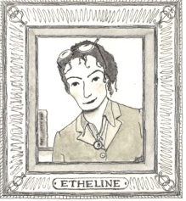
DIEGESIS v. NON-DIEGETIC ELEMENTS
Diegesis –anything that exists in the world of the story.
Characters are aware of anything that is diagetic.
Examples: setting, other characters, dialogue, story elements, plot, etc.
Non-diegetic elements –things that only the viewer can perceive
Used to enhance mood and establish tone
Examples: music, coloration, text, narration, pacing
Non-diagetic examples:
https://www.youtube.com/watch?v=Rk1aQx9hTaE
https://www.youtube.com/watch?v=5QcP-XeD9bo

Slide 10
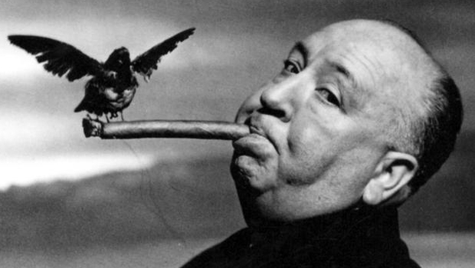
The Master of Suspense:
“Film is not a slice of life. It’s a piece of cake.”
“Actors are cattle”
“The length of a film should be directly related to the endurance of a human bladder.

Slide 11
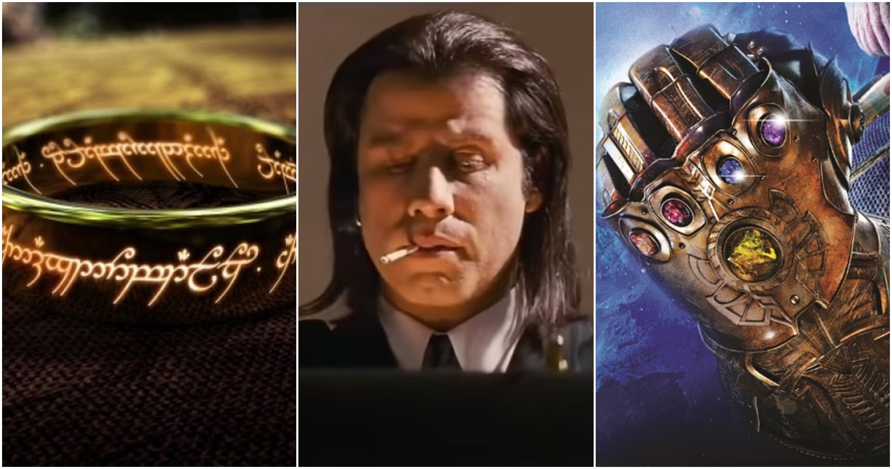
The MacGuffin
https://www.youtube.com/watch?v=QcxhklyiMqo

Slide 12
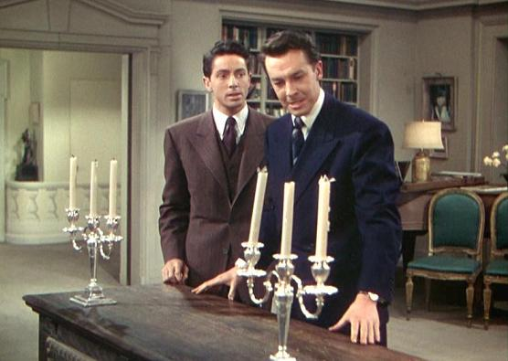
What makes Rope a unique film?
HINT: It has to do with the fact that it is meant to look like one take.
Think of the sunset outside the window.

Slide 13
Fabula (фабула) and Syuzhet (сюжет)
Fabula –The uncut, unaltered world of the story.
This is what the characters experience
This includes going to the bathroom, eating, commutes, sleeping
Real time / “Raw Material”
Syuzhet –The condensed version of the story that we view
Used to tell the story in an effective manner
Author / director choose what is vital
In some ways, the syuzhet is non-diegetic (the characters are unaware that their story is being truncated)
Narrative Theory developed by Vladimir Propp and Viktor Shklovsky adapted from Aristotle’s Poetics

