Slide 1
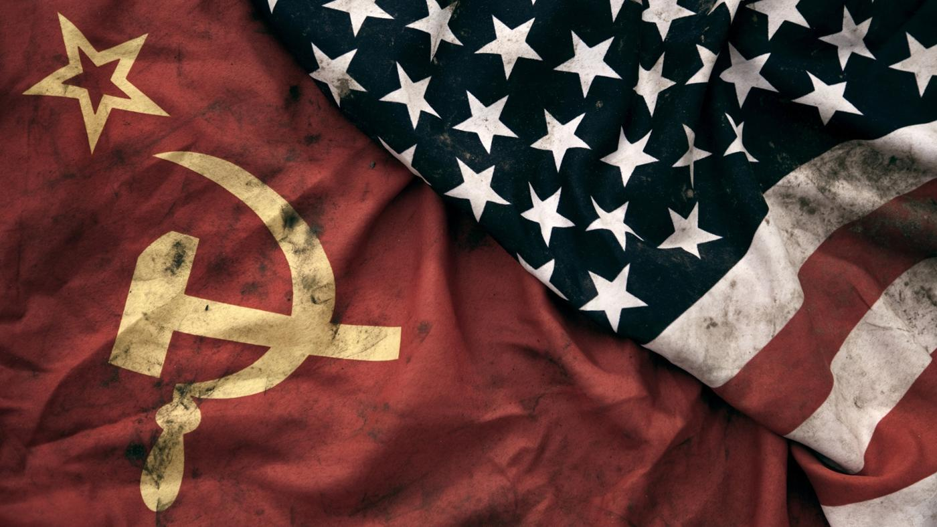
How did the Cold War and Communism redefine what it meant to be an American?

Slide 2
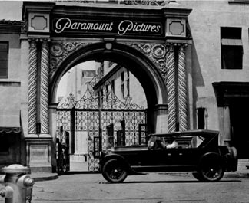
Movie attendance drops:
91 million a week (1948)
51 million a week (1952)
Family audience only turns out for Disney productions
Vertical controlled deemed similar to a “monopoly” –U.S. v. Paramount Pictures
Independents given more power

Slide 3
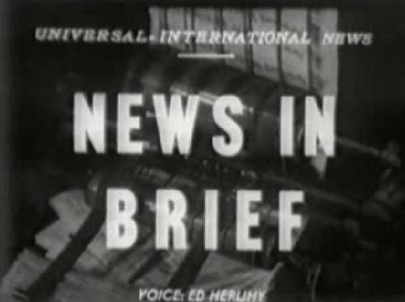
1950s Change in Presentation
No more cartoons, newsreels, short subjects, and double features
B-movies (in their original forms) were scrapped
Ida Lupino – “Queen of the Bs” –only woman working as a director in the 1950s
B-movies would later be seen as art by some
Major B-movies: The Bigamist (1953), Hard, Fast, and Beautiful (1951), The Hitchhiker (1953)

Slide 4
What hurt cinema? ECONOMIC PROSPERITY and INVENTION!
Spectator sports, bowling, motorboating, hi-fi sets, activities
TELEVISION! –executives buried heads in sand and refused to acknowledge

Slide 5
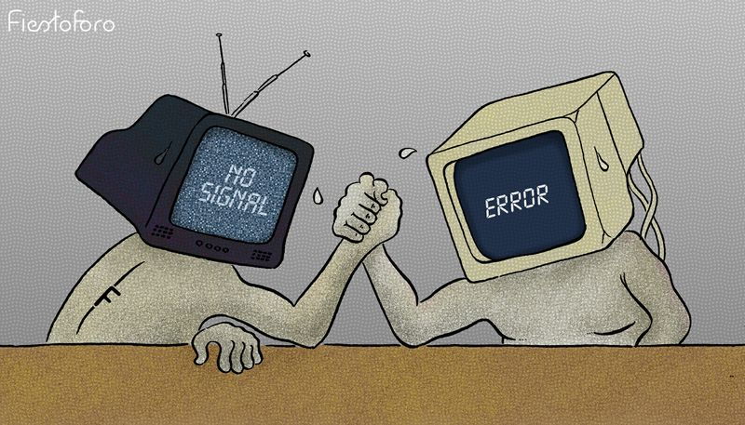
How is TV repeating the mistakes of yesteryear?
What do you predict will be the result?
What will TV and film look like in a decade? Two decades?

Slide 6
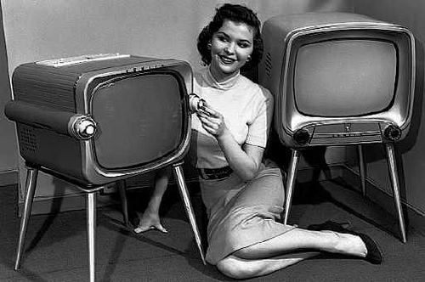
THE WAR WITH TELEVISION
Studio execs refused to acknowledge the impact of television
Word “television” barred from executive meetings
Contracted actors, writers, and directors banned from working for television
TV wouldn’t advertise theaters that played studio films
No feature films played on TV
Studio abandoned theater owners after vertical control broken up
Eventually, studios released canon of films to TV
1952 –Columbia Pictures creates “Screen Gems”, making content for television

Slide 7
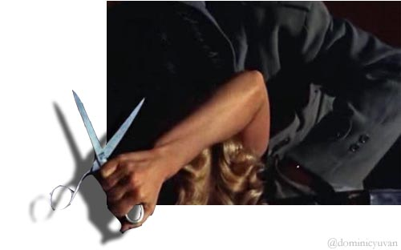
GIMMICKS TO SAVE FILM
1952 -3D (there technically was 3D before this, but not on a mass scale) –initial success, but tapered off after a year
Widescreen / Cinerama -2.85 to 1 ratio: Developed as a military training idea, too cumbersome. Evolved into CinemaScope, which eliminated peripheral (Fox made bank on CinemaScope)
Higher def –pictures, including audio

Slide 8
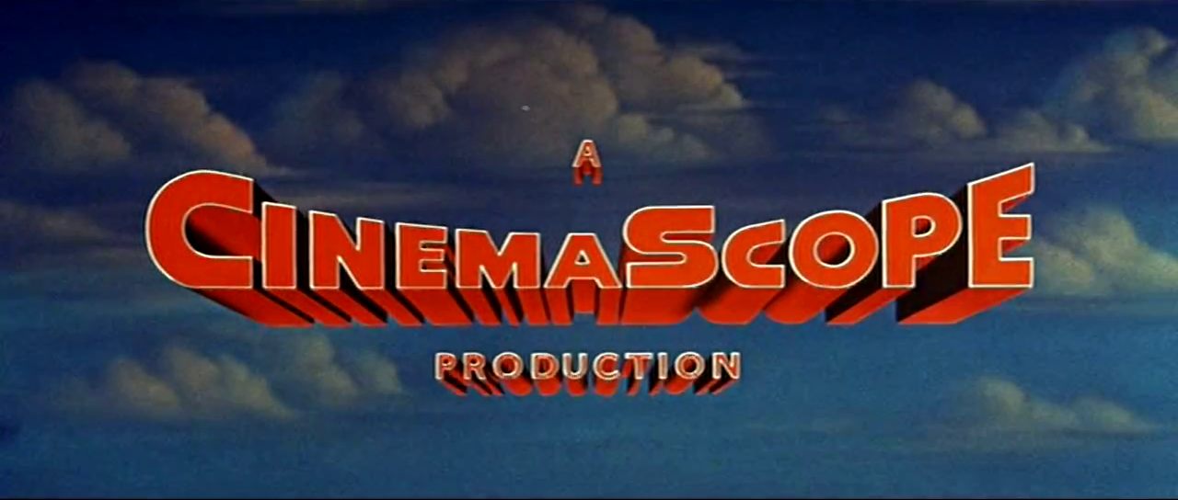
The Battle for Widescreen
Some people thought it was a gimmick; “like looking at the world through a postal slot”
Quickly took off
Very inexpensive transition; theaters didn’t have to be rebuilt
Paramount responded with VistaVision –provided sharper image than CinemaScope
Today, we use Panavision
Standard widescreen is now 1.85 to 1

Slide 9
The Birth of the Independent Film
Important note: While every studio was all about vertical control pre-1950s, United Artists was in the loosest sense a film studio. Many of the choices that will happen are modeled off of their business practices.
Vertical Control became about who could acquire more film starts and more assets
The problem was that they couldn’t possibly make movies with all of those starts
MGM advertised having “More Stars Than in the Heavens” or something like that.
Money is just being thrown at assets who aren’t working
United Artists was on a model of buying up independent film and distributing it to independent theater owners
Would take a major chunk of the profits
Billy Wilder: “We used to make pictures; now we make deals”
Long term contracts dissolved; UA starts thriving
Studios start renting out space for independents
It’s why there are a million production logos before a movie now
Production company had major influence over independent film
Still few made; independents had to come up with capital themselves and it HAD to be successful

Slide 10
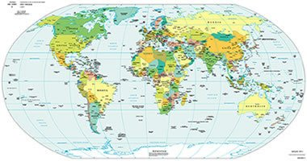
Internationalization of film
Artistic choices: sometimes shooting in Paris is more romantic than a soundstage
Financial: International cast draws international audience; cheaper in other countries
Import: Studios could release foreign films domestically
Access to local work: Studios could be built worldwide

Slide 11
The Loosening of Content
Religious, ethnic, and political groups focused on TV rather than film
1915: Films considered “business”, not “art”
1952: “Miracle” case: movie deemed sacrilegious, but falls under standards of free speech / art
1950s (in general) –Two “A” films released by United Artists against MPAA code. Films released anyway because no vertical control
1966: Jack Valenti heads MPAA; liberalizes Code
1968: Age rating system adopted by MPAA
1973: Obscenity deemed by local courts; causes all kinds of problems (movies deemed okay in some places considered offensive other places)
Weirdly, there are still problems with the code. There’s a documentary called This Film is Not Yet Rated, criticizing the industry. Appropriately, it is NC-17

Slide 12
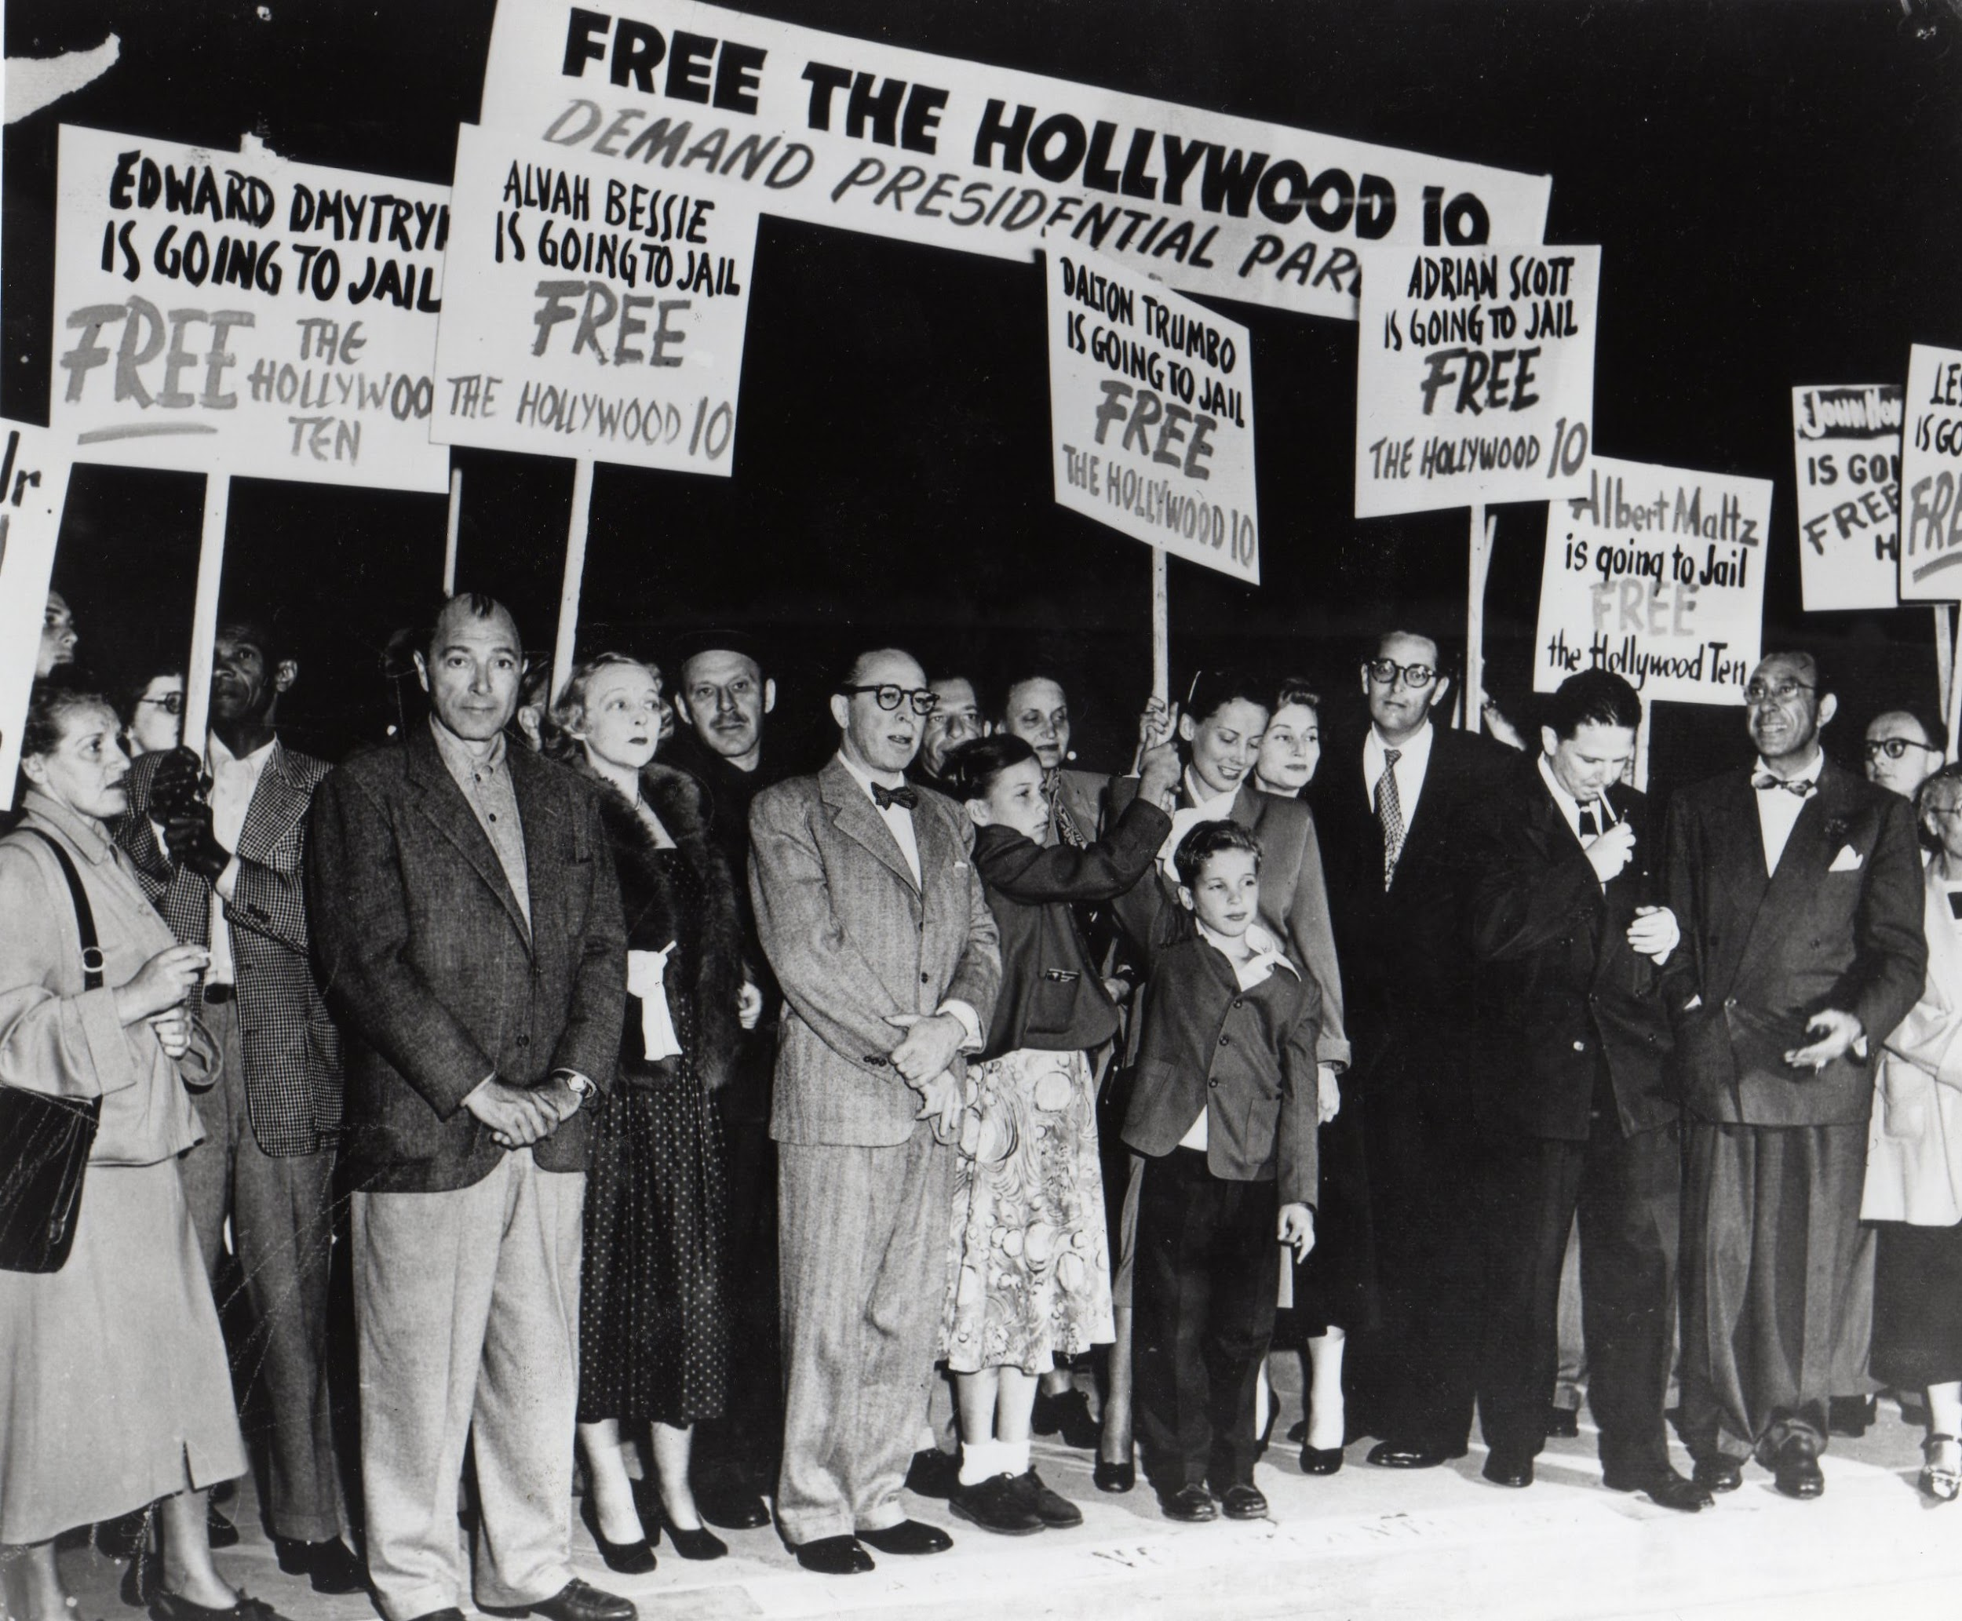
Statement from the former Committee for the First Amendment:
“We will not knowingly employ a Communist or a member of any party or group which advocates the overthrow of the Government of the United States by force or by any illegal or unconstitutional methods.”
Why sell out the Hollywood Ten?

Slide 13
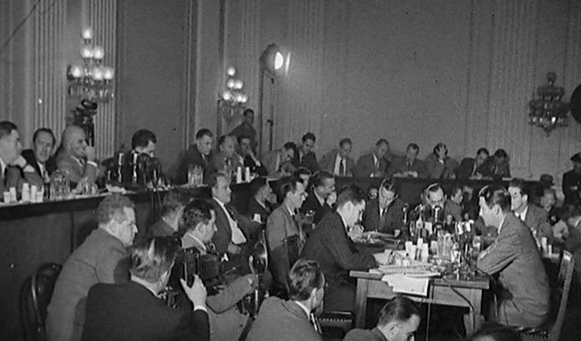
HUAC Continued
American Legion most vocal supporter of Hollywood “[cleaning] house”
1951 to 1954, “mass hearings” began of more than 200 motion picture workers
Witnesses for defense became subjects of hearing
Pleading the Fifth assumed guilty
Banner extended to liberals who clearly were not Communists
Had to write public letters of apology claiming to sin no more
Behind the scenes, people still worked anonymously
Blacklisted actors and actresses could not work

Slide 14
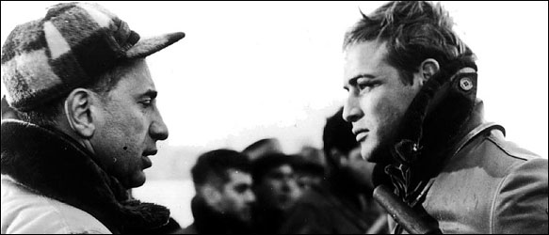
ELIA KAZAN
Extremely famous director of both theatre and film
Confesses to being a member of the Communist Party between 1934 and 1936
Names other Party members
Places ad in The New York Times explaining his decision to confess
Future films, especially On the Waterfront, deal with Kazan’s struggles and justification of his choices. In many ways, it is a response to The Crucible

Slide 15
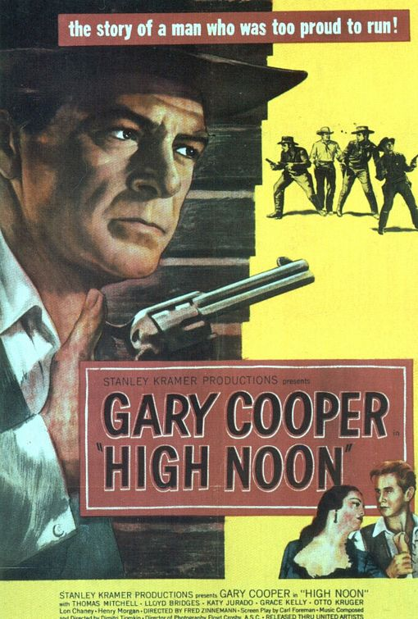
HIGH NOON (1952)
Directed by Fred Zinnermann
Produced by Stanley Kramer
Allegory for McCarthyism
Carl Foreman, the scriptwriter, was blacklisted, exiled, and lived in England

Slide 16
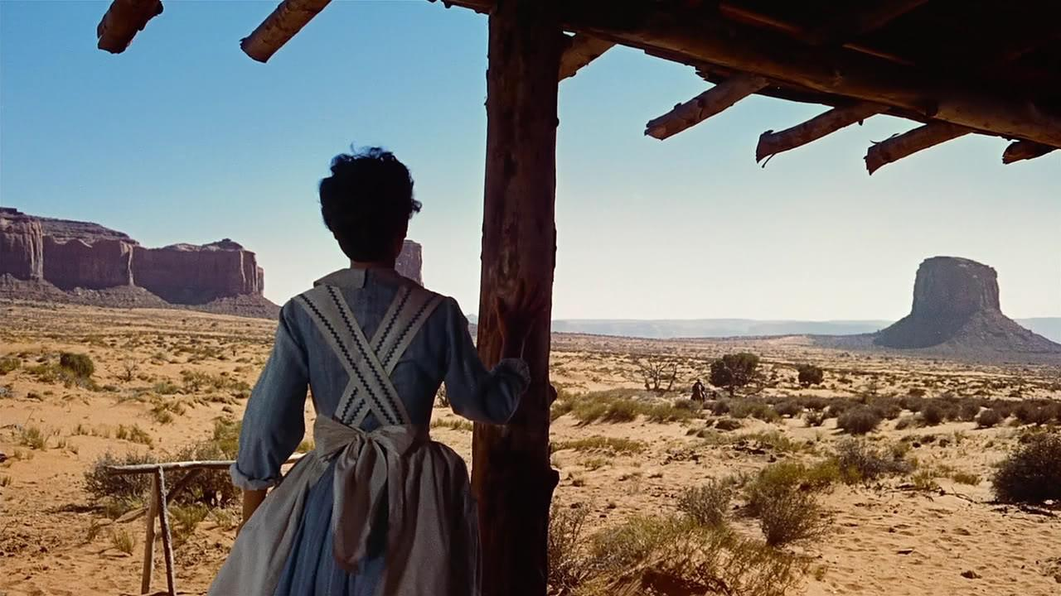
Westerns
Find resurgence, bigger budgets, established directors
Red River (1948 –Howard Hawks), The Man from Laramie (1955, Anthony Mann), The Tall T (1957, Budd Boetticher) , The Searchers (1956, John Ford), Shane (1953, George Stevens)

Slide 17
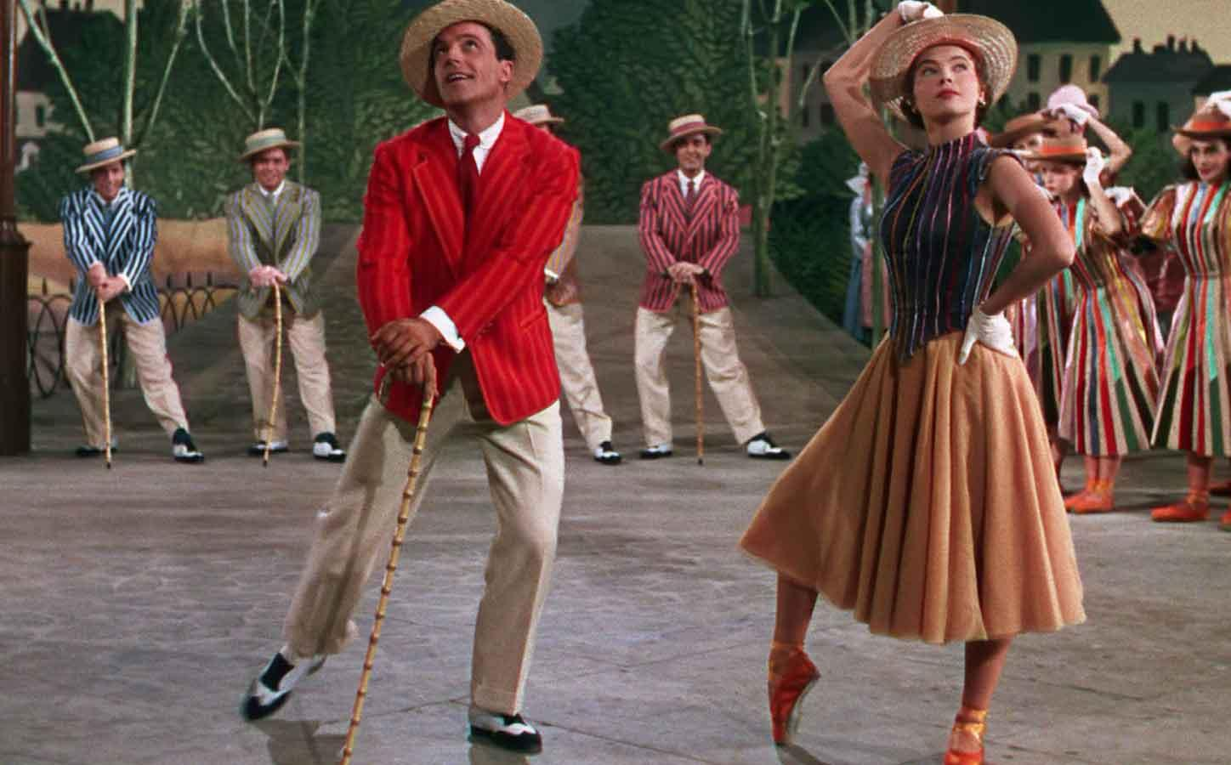
MUSICALS
Less complicated world than Western
Richard Dyer argued that these films present a utopian vision that sets forth a world filled with abundance and pleasure
Best musicals made at MGM
Names to know: Fred Astaire, Vera Ellen, Doris Day, Gene Kelly
An American in Paris (1951), Singin’ in the Rain (1952), Gentlemen Prefer Blondes (1953)

Slide 18
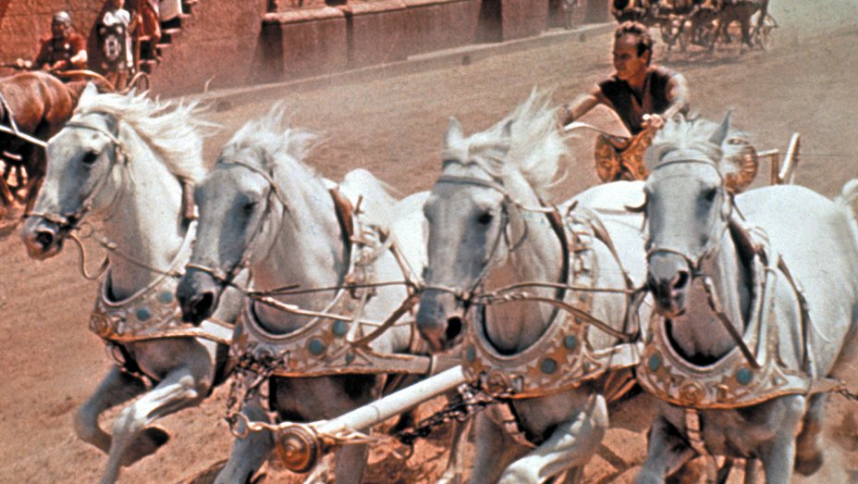
Biblical Epics
Quo Vadis (Mervyn LeRoy, 1951)
The Robe and The Ten Commandments (Cecil B. DeMille, 1956)
Ben-Hur (William Wyler, 1959)

Slide 19
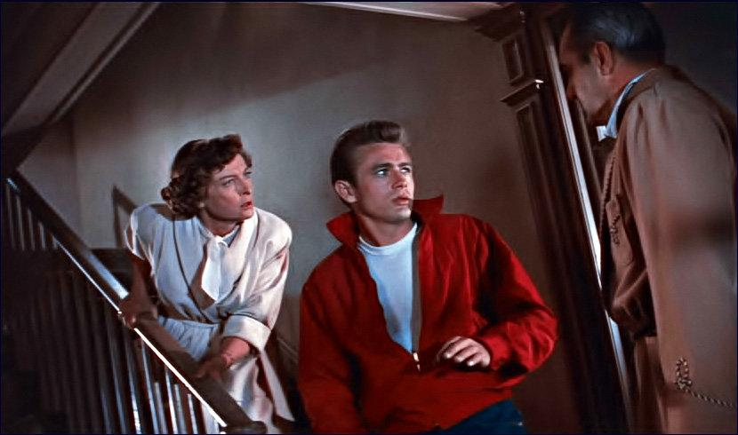
Juvenile Delinquent Films –response to the government fearing everyone
Aimed at teenagers
1955 –The Blackboard Jungle, 1953 –The Wild One, 1955 –Rebel Without a Cause
James Dean and Marlon Brando –both coincidentally method actors

Slide 20
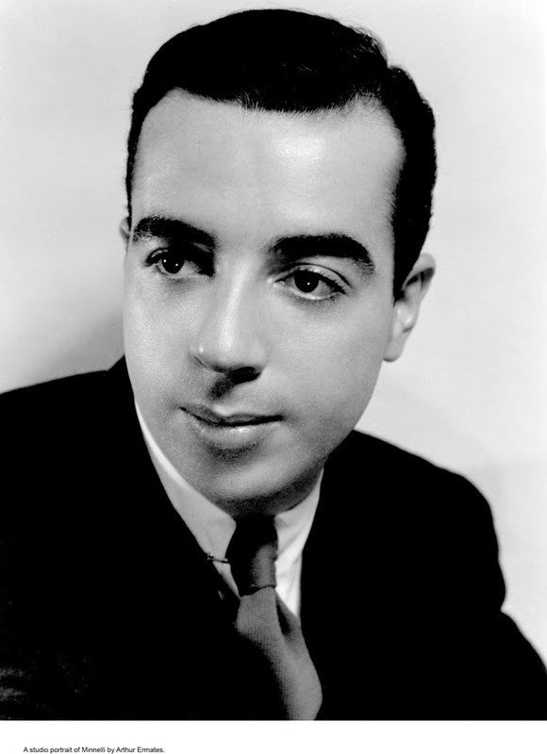
VINCENTE MINELLI
Starts off as a stage designer and director
Produced Meet Me in St. Louis and The Pirate
Known for directing musicals
Directed original Father of the Bride
Musicals usually surround the life and struggles of theatre or creative types.
Films: An American in Paris, The Band Wagon, Brigadoon, Gigi

Slide 21
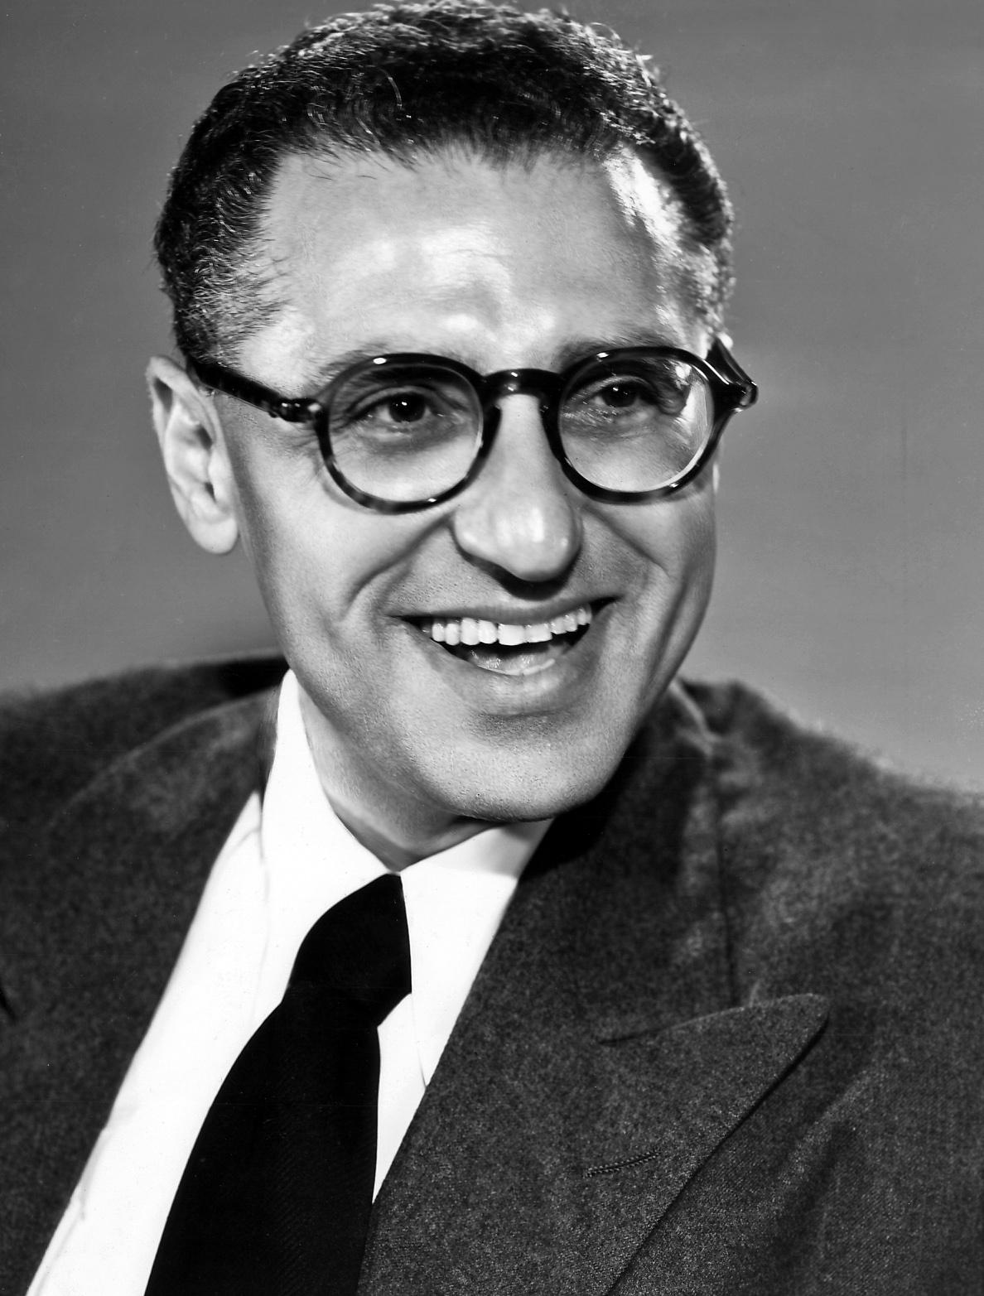
George Cukor
One of the first openly gay directors in Hollywood
Hosted huge parties often
Known for bringing out amazing performances out of his female leads
Specialized in literary adaptations, sophisticated comedies, musicals, and period pictures
Films: A Double Life, Adam’s Rib, Born Yesterday, A Star is Born, My Fair Lady

Slide 22
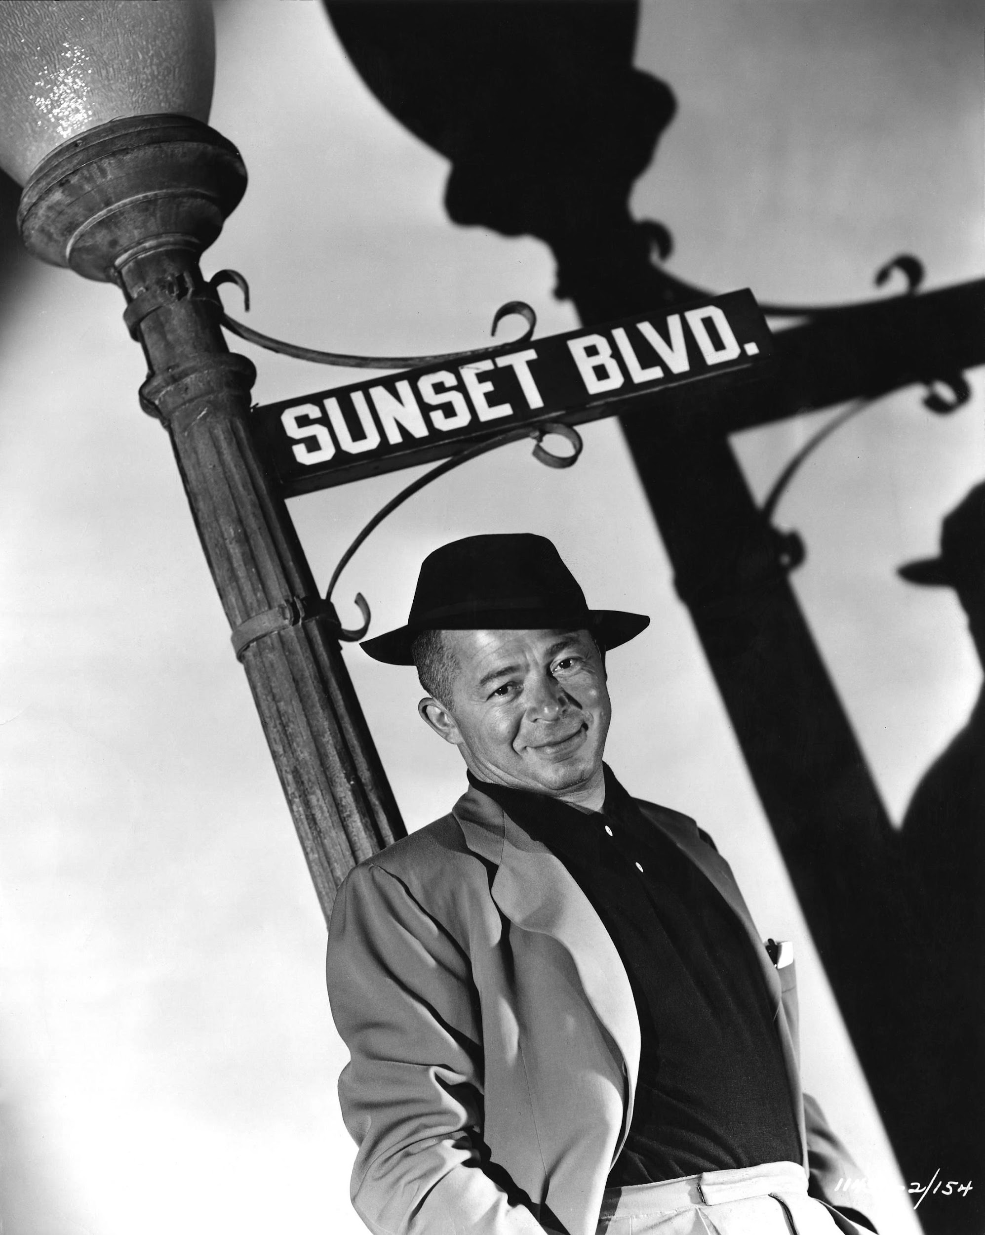
Billy Wilder
Started as a scriptwriter for Lubisch and Hawks
Turned to direction to “protect [his] scripts”
Directed film noir, dramas, and comedies
Films: Double Indemnity, Sunset Boulevard, Ace in the Hole, Stalag 17, Sabrina, Love in the Afternoon, The Seven Year Itch, Some Like It Hot, The Apartment

Slide 23
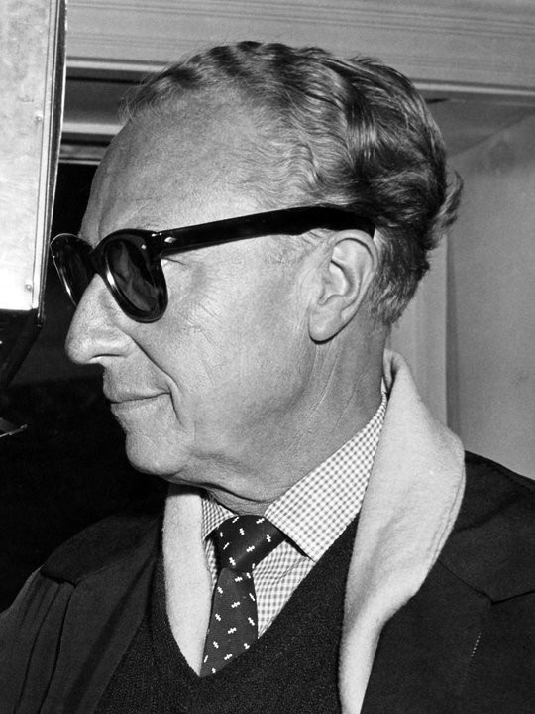
Douglas Sirk
German immigrant
Known for the “woman’s picture”
Made Rock Hudson famous
Creator of “Sirkian irony” –when melodrama is emotionally manipulative, but with an awareness that it is manipulative
Used mise-en-scene to comment on character (especially mirrors and glass surfaces)
Films: All That Heaven Allows, Written on the Wind, Imitation of Life

Slide 24
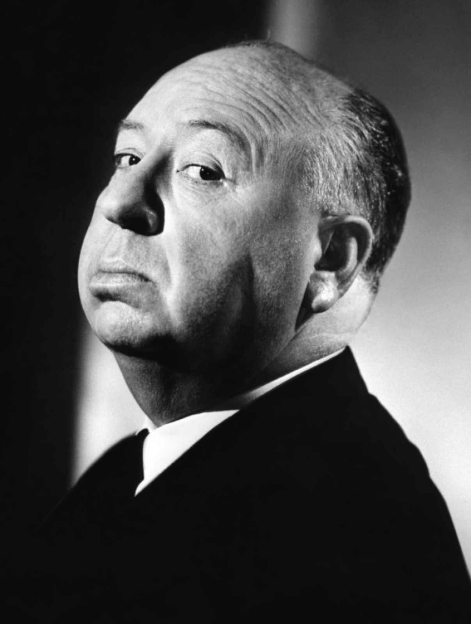
This Guy
Am I right?
Films: Corpse Mom, Pigeons, Help! I’m Afraid of Heights, Suicide Squad

