Slide 1
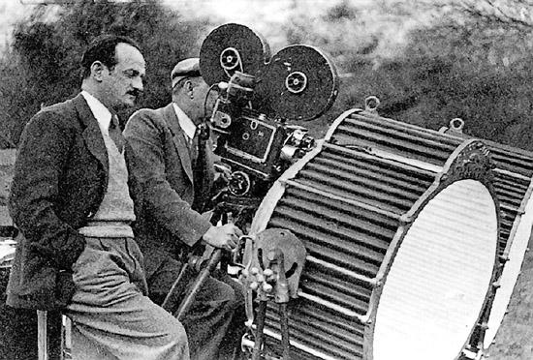
How do Hollywood producers affect movies even more so than the director? How might this have been more important in the 1930s and 1940s?

Slide 2
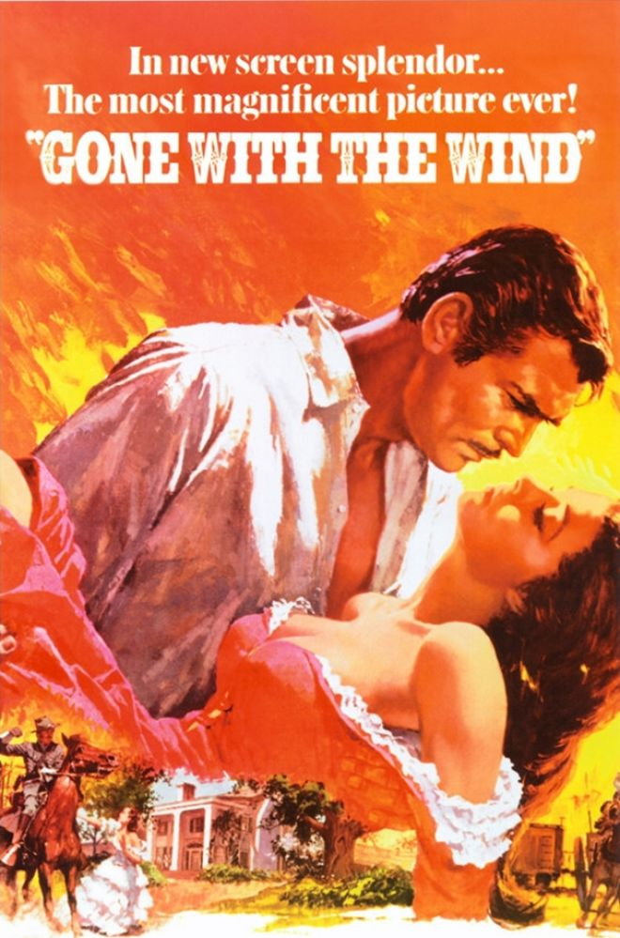
Distributors in the 1930s
In charge of advertising
Designed graphics
Wrote advertising copy
Actually wrote their own prewritten reviews
Publicity for the public sounded like this:
“For the first time on the screen…”
“”At last it can be told…”
“Never before in the history of the motion picture…”
The big push for the public was “breaking new ground”
Studios advertised to smaller distributors how the films were similar to other movies. (Example: From the team that brought you Dark Victory)

Slide 3
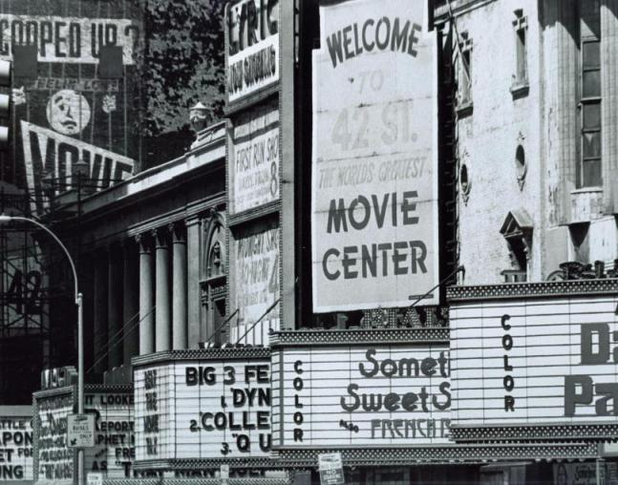
Block booking –exhibitor had to rent films in packages; these packages always had a mix of both good and bad movies
Blind buying –exhibitor had to rent a movie unseen, sometimes unmade, to advance the market
Overbuying –exhibitors forced to rent more movies than they could show
Clearance / zoning – only perk for being a distributor? You got special permission to be the only one in a region to show a certain movie.

Slide 4
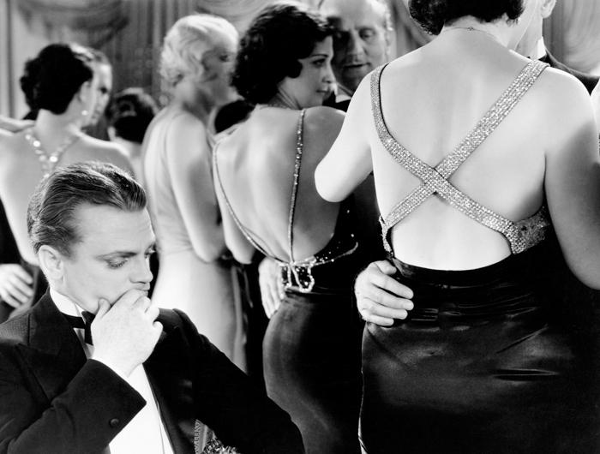
Censorship and film ratings:
Since vertical control was king, studios decided what was vulgar.
Society demanded some form of regulation.
Advertising was intentionally pushing the envelope.
Studios were intentionally making movies more lewd and more violent.
The Fatty Arbuckle scandal alienated the common man from Hollywood.

Slide 5
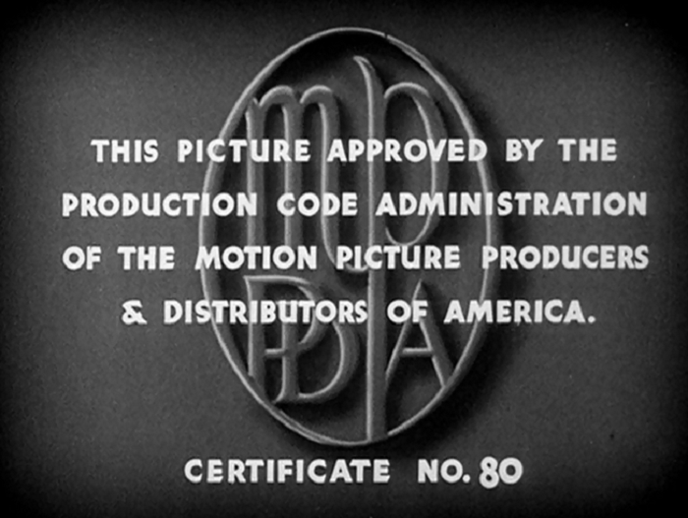
The Motion Picture Production Code (1922-1968)
Not a government agency
Still studio regulated
Worded like the Ten Commandments (You can’t do this, you can’t do that)
Catholic organization, “The Legion of Decency” boycotted any movie that did not meet the code.
For two decades, no movies were released without code approval.

Slide 6
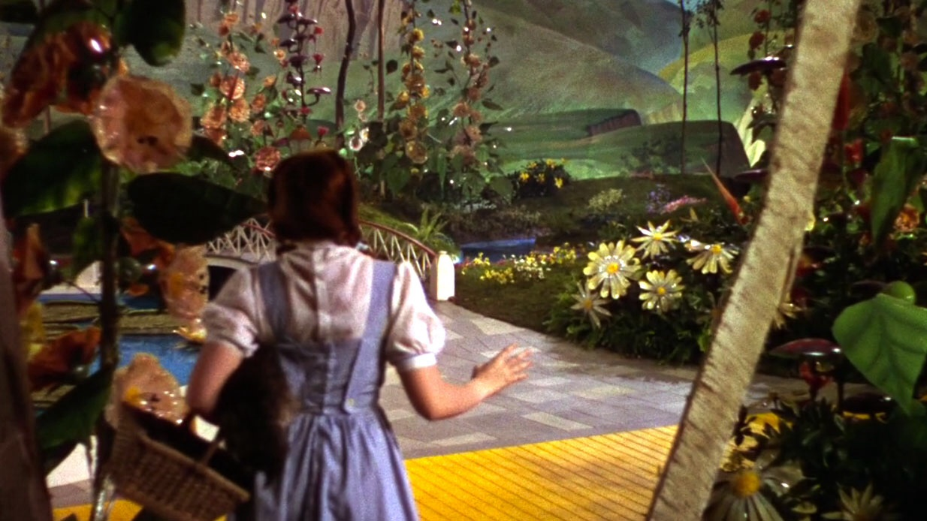
Why is this moment so important for audiences?

Slide 7
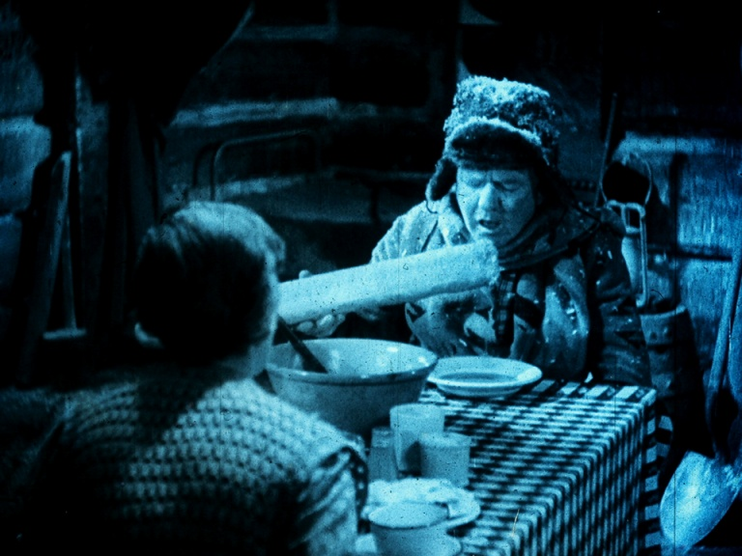
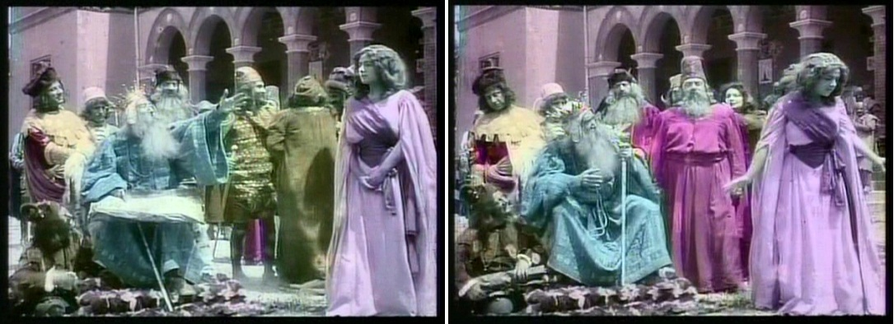
Film tinting –the entire cell is washed with a single color to establish mood or time of day.
Hand coloring – labor intensive and doesn’t give the same look as technicolor.

Slide 8
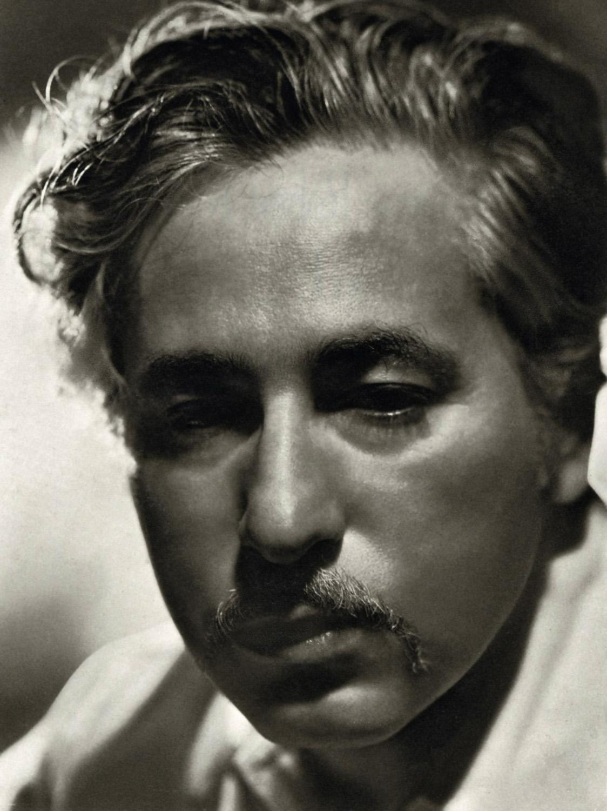
Josef von Sternberg
Believed that film should be aesthetically pleasing no matter which way you looked at it (upside-down and backwards…)
Most likely handled cinematography himself
Obsessed with lighting and mise en scene
Famous films:
Morocco (1930)
Dishonored (1931)
Shanghai Express (1932)
Scarlet Empress (1934)
The Devil is a Woman (1935)

Slide 9
The Dawn Patrol (1930)
Twentieth Century (1934)
Bringing Up Baby (1938)
Only Angels have Wings (1939)
Howard Hawks:
Made some really bro-ey movies (I’m saying the dude made movies for dudes and was probably a huge sexist.)
Themes and motifs: professionalism, individual courage, loyalty, friendship among men, battles between the sexes
Made aerial combat movies and screwball pictures

Slide 10
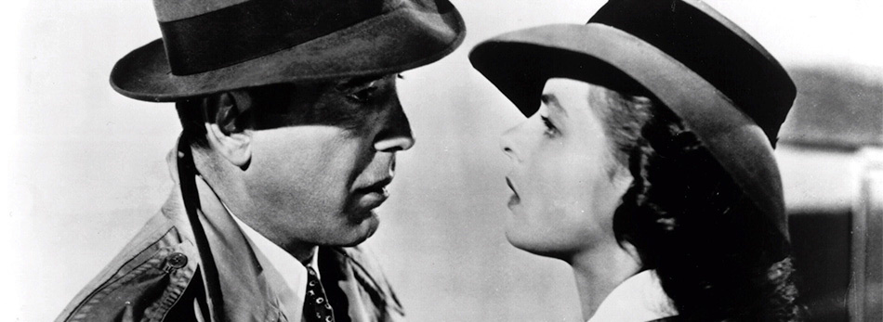
Quick! Name some films from 1930s and 1940s Hollywood.
(Take a guess...)

Slide 11
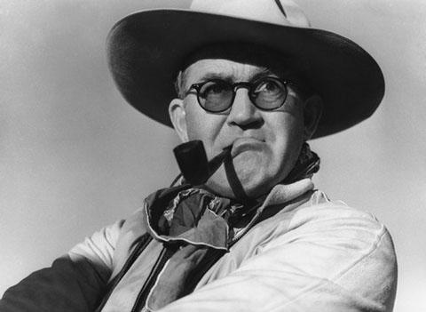
John Ford
I think of him as the Ernest Hemingway of film directors: grizzled and manly
He was the champion of the Western (but, like, genuinely. The man knew how to shoot a Western well)
Discovered John Wayne
Loved the beauty of the American West
Common Motifs: Graveyard scenes, old timey folk music, revenge
Films to know:
Steamboat ‘Round the Bend (1935)
Prisoner of Shark Island (1936)
Stagecoach (1939)
Young Mr. Lincoln (1939)
P.S. If anyone finds a copy of Stagecoach, it’s mine.

Slide 12
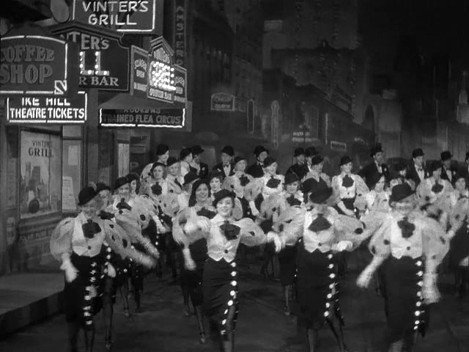
Musicals
1933 -42nd Street introduced the big budget, singing and dancing spectacle
Jazz Singer considered a “backstage musical”
Previous releases were revues –linked musical acts that didn’t tie into unreality
Busby Berkeley: Champion of musical

Slide 13
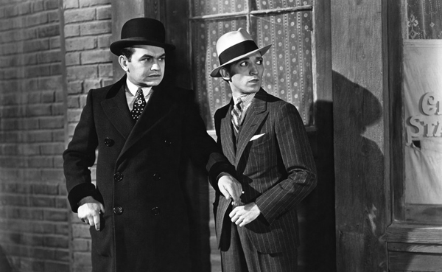
Gangster films
Blossom in the 1930s; die off for a long time afterwards
Edward G. Robinson sets archetype
Antihero’s quest for power leads to downfall
Big films: Little Caesar (1930), Public Enemy (1931), Scarface (1932)

Slide 14
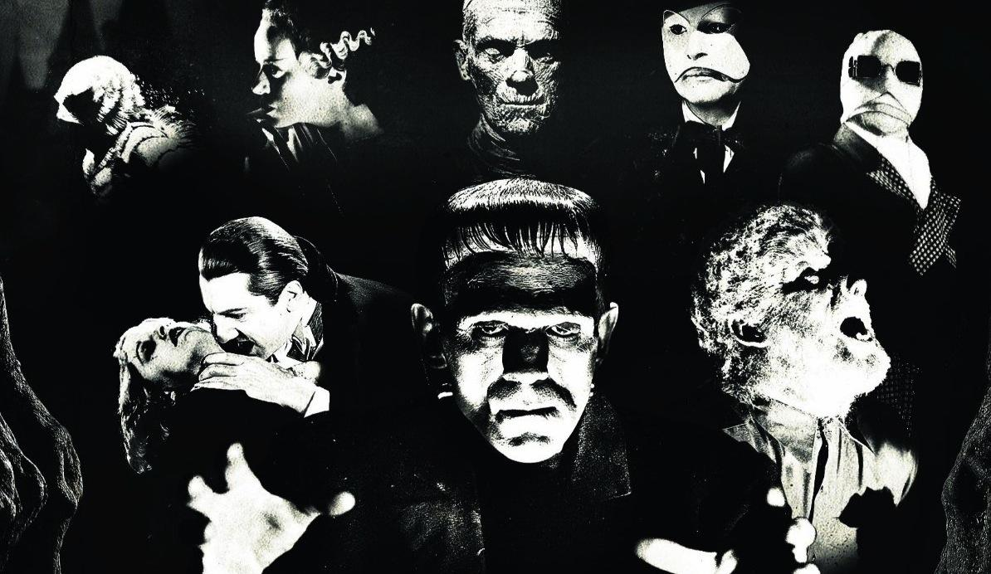

Slide 15
Drawing Room Comedies:
We talked about these in the 1920s era
These are the Lubitsch comedies of manners / satirical
Wit and double entendre
Trouble in Paradise (1932)
Vaudeville / Stage Acts:
Similar to Charlie Chaplin, just add talking
The Marx Brothers
W.C. Fields
Mae West
Often a mix of puns and wordplay added with physical comedy –played versions of themselves.
Screwball Comedy:
Mix of the first two groups: Intellectual sophistication with slapstick humor
Drew famous actors to these movies
It Happened One Night (1934), His Girl Friday (1940), The Lady Eve (1941)

Slide 16
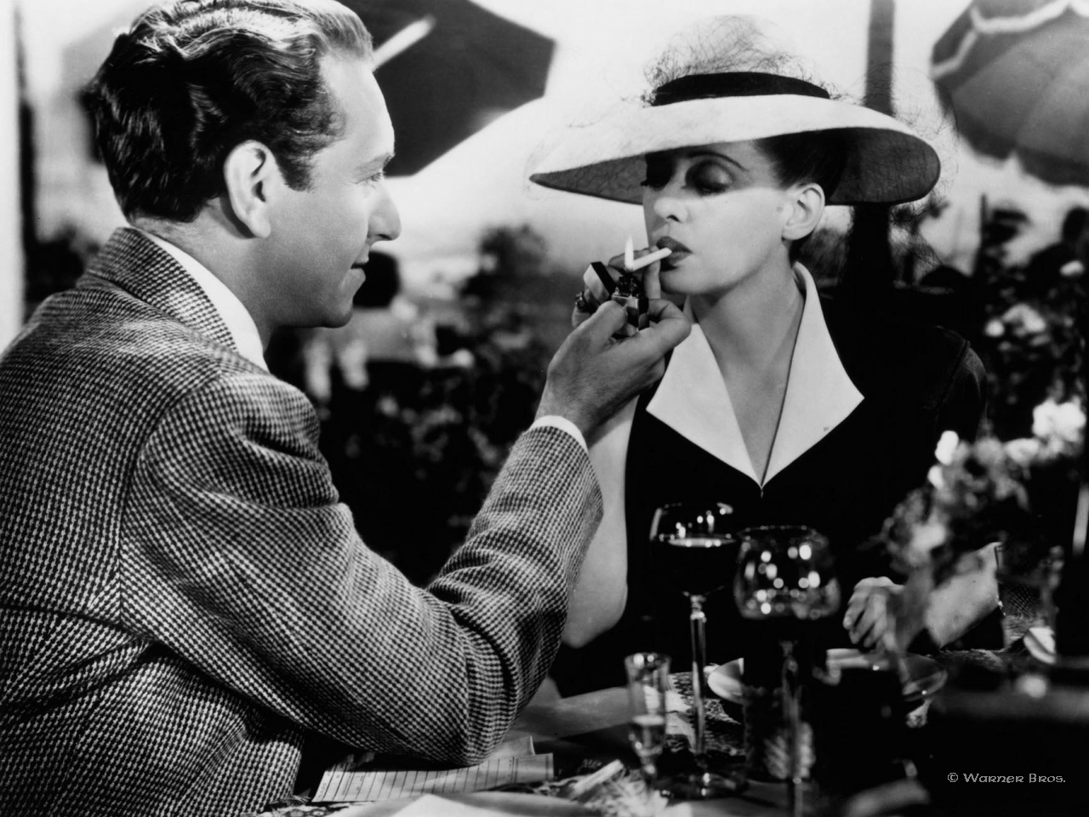
Women’s Pictures: Aimed at a female audience who frequented matinee showings
Love stories –Camille (1937)
Domestic Melodramas –Focused on the problems of the family and the home (precursor to soap operas) Now, Voyager (1942), Mildred Pierce (1945)
Dorothy Arzner –Hollywood’s only major female director at the time. Directed “Women’s Pictures”; celebrated women’s lives and women’s relationships

Slide 17
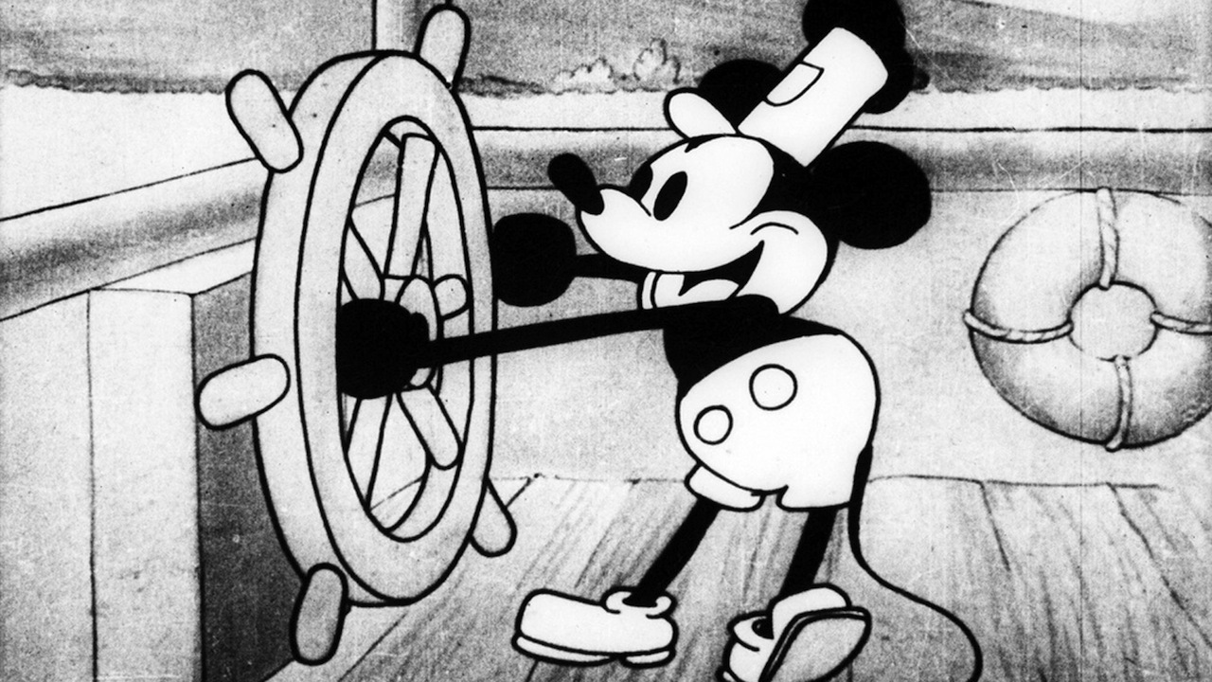
1928

Slide 18
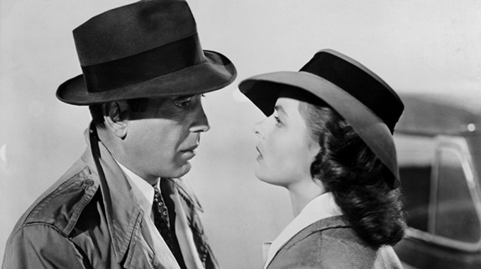
World War II stopped foreign markets from making movies, but Hollywood kept business as usual. Movies were adapted to address the war, but weren’t necessarily war movies.

Slide 19
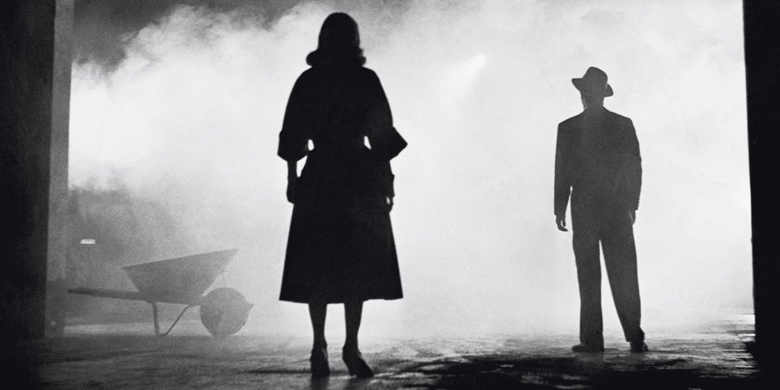
Film Noir – we studied this with German Expressionism and Fritz Lang
Predominant use of shadows
Protagonists often antiheroes, trapped and seeking a way out of problem
Antagonists – seductive women (femme fatales), career criminals, worldly foreigners, upper class
People to know:
Fritz Lang – M, The Woman in the Window
Billy Wilder – Double Indemnity
John Huston –The Maltese Falcon, The Asphalt Jungle, Key Largo

Slide 20
