Slide 1
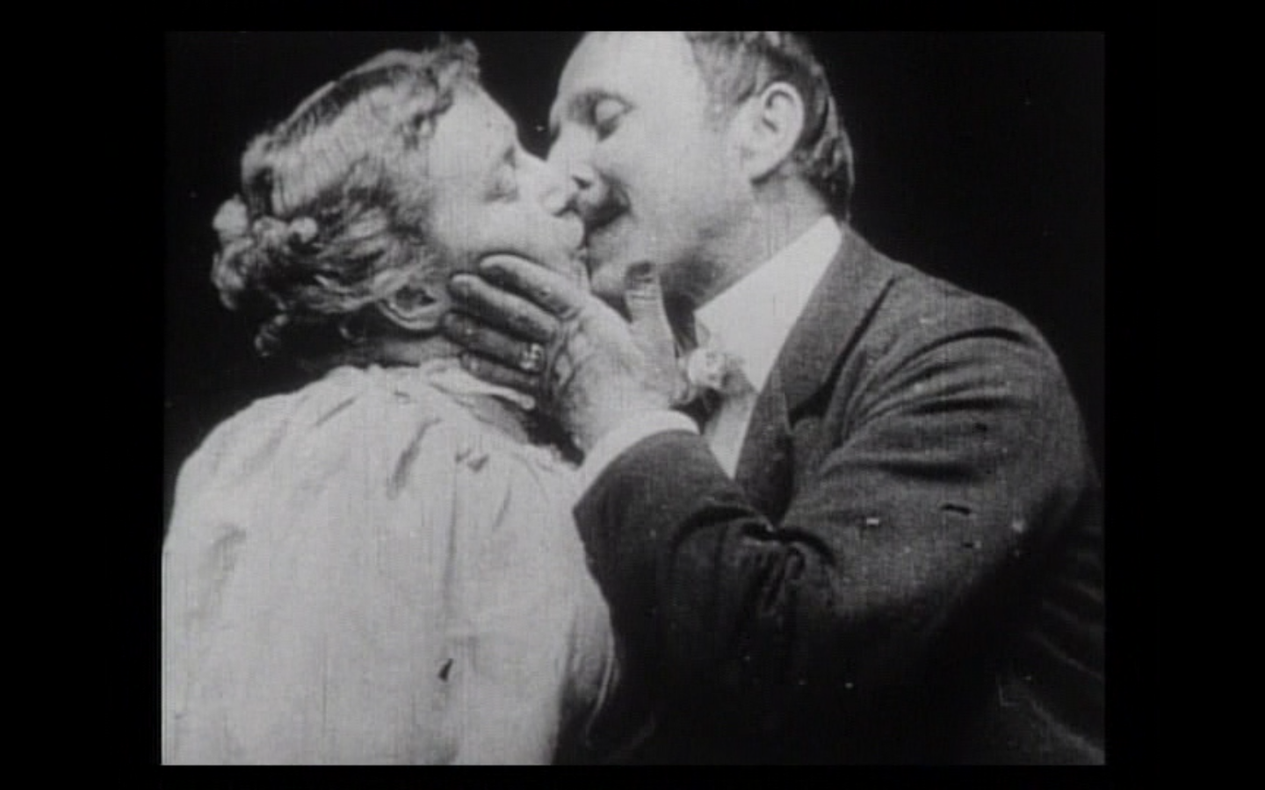
`
What fundamental differences were there between films in the 1890s and films of any other era?

Slide 2
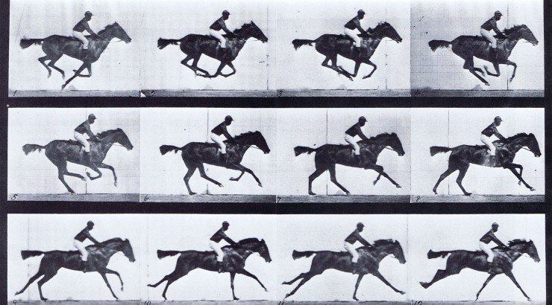
KNOW THESE TERMS: 1. Temporal organization 2. Spatial composition

Slide 3
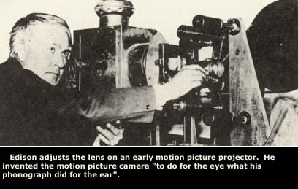

Slide 4
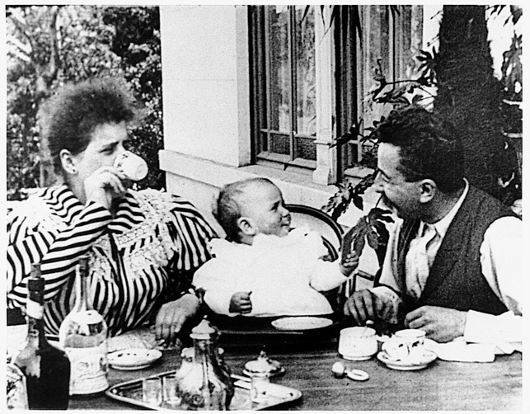
One of the first actualities –Lumieres’ Feeding the Baby
Actualites (or Actuality film) –a precursor to documentaries. This is simply non-fiction footage of an event.

Slide 5
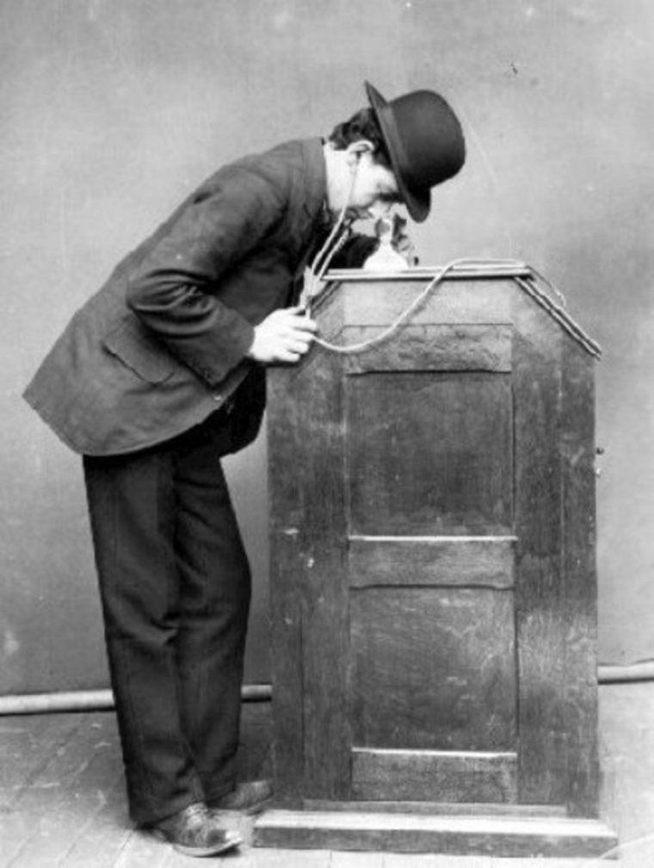
The Edison Kinetoscope (Peep-show Machine)
It would not be until the Lumiere brothers projected the image onto a sheet in December of 1895 when public showings would be commonplace.

Slide 6
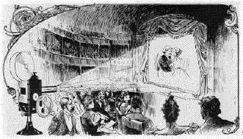
Philosophical differences
Koster and Bial (New York) –Pack in as many people as humanly possible to make the most money; spectacle
Grand Cafe; Lumiere (Paris) –The artistry matters. “It is life itself.”

Slide 7
To Do List
HOMEWORK: Read Chapter One, p. 3-8. Take notes.
Discuss tracking shots

Slide 8
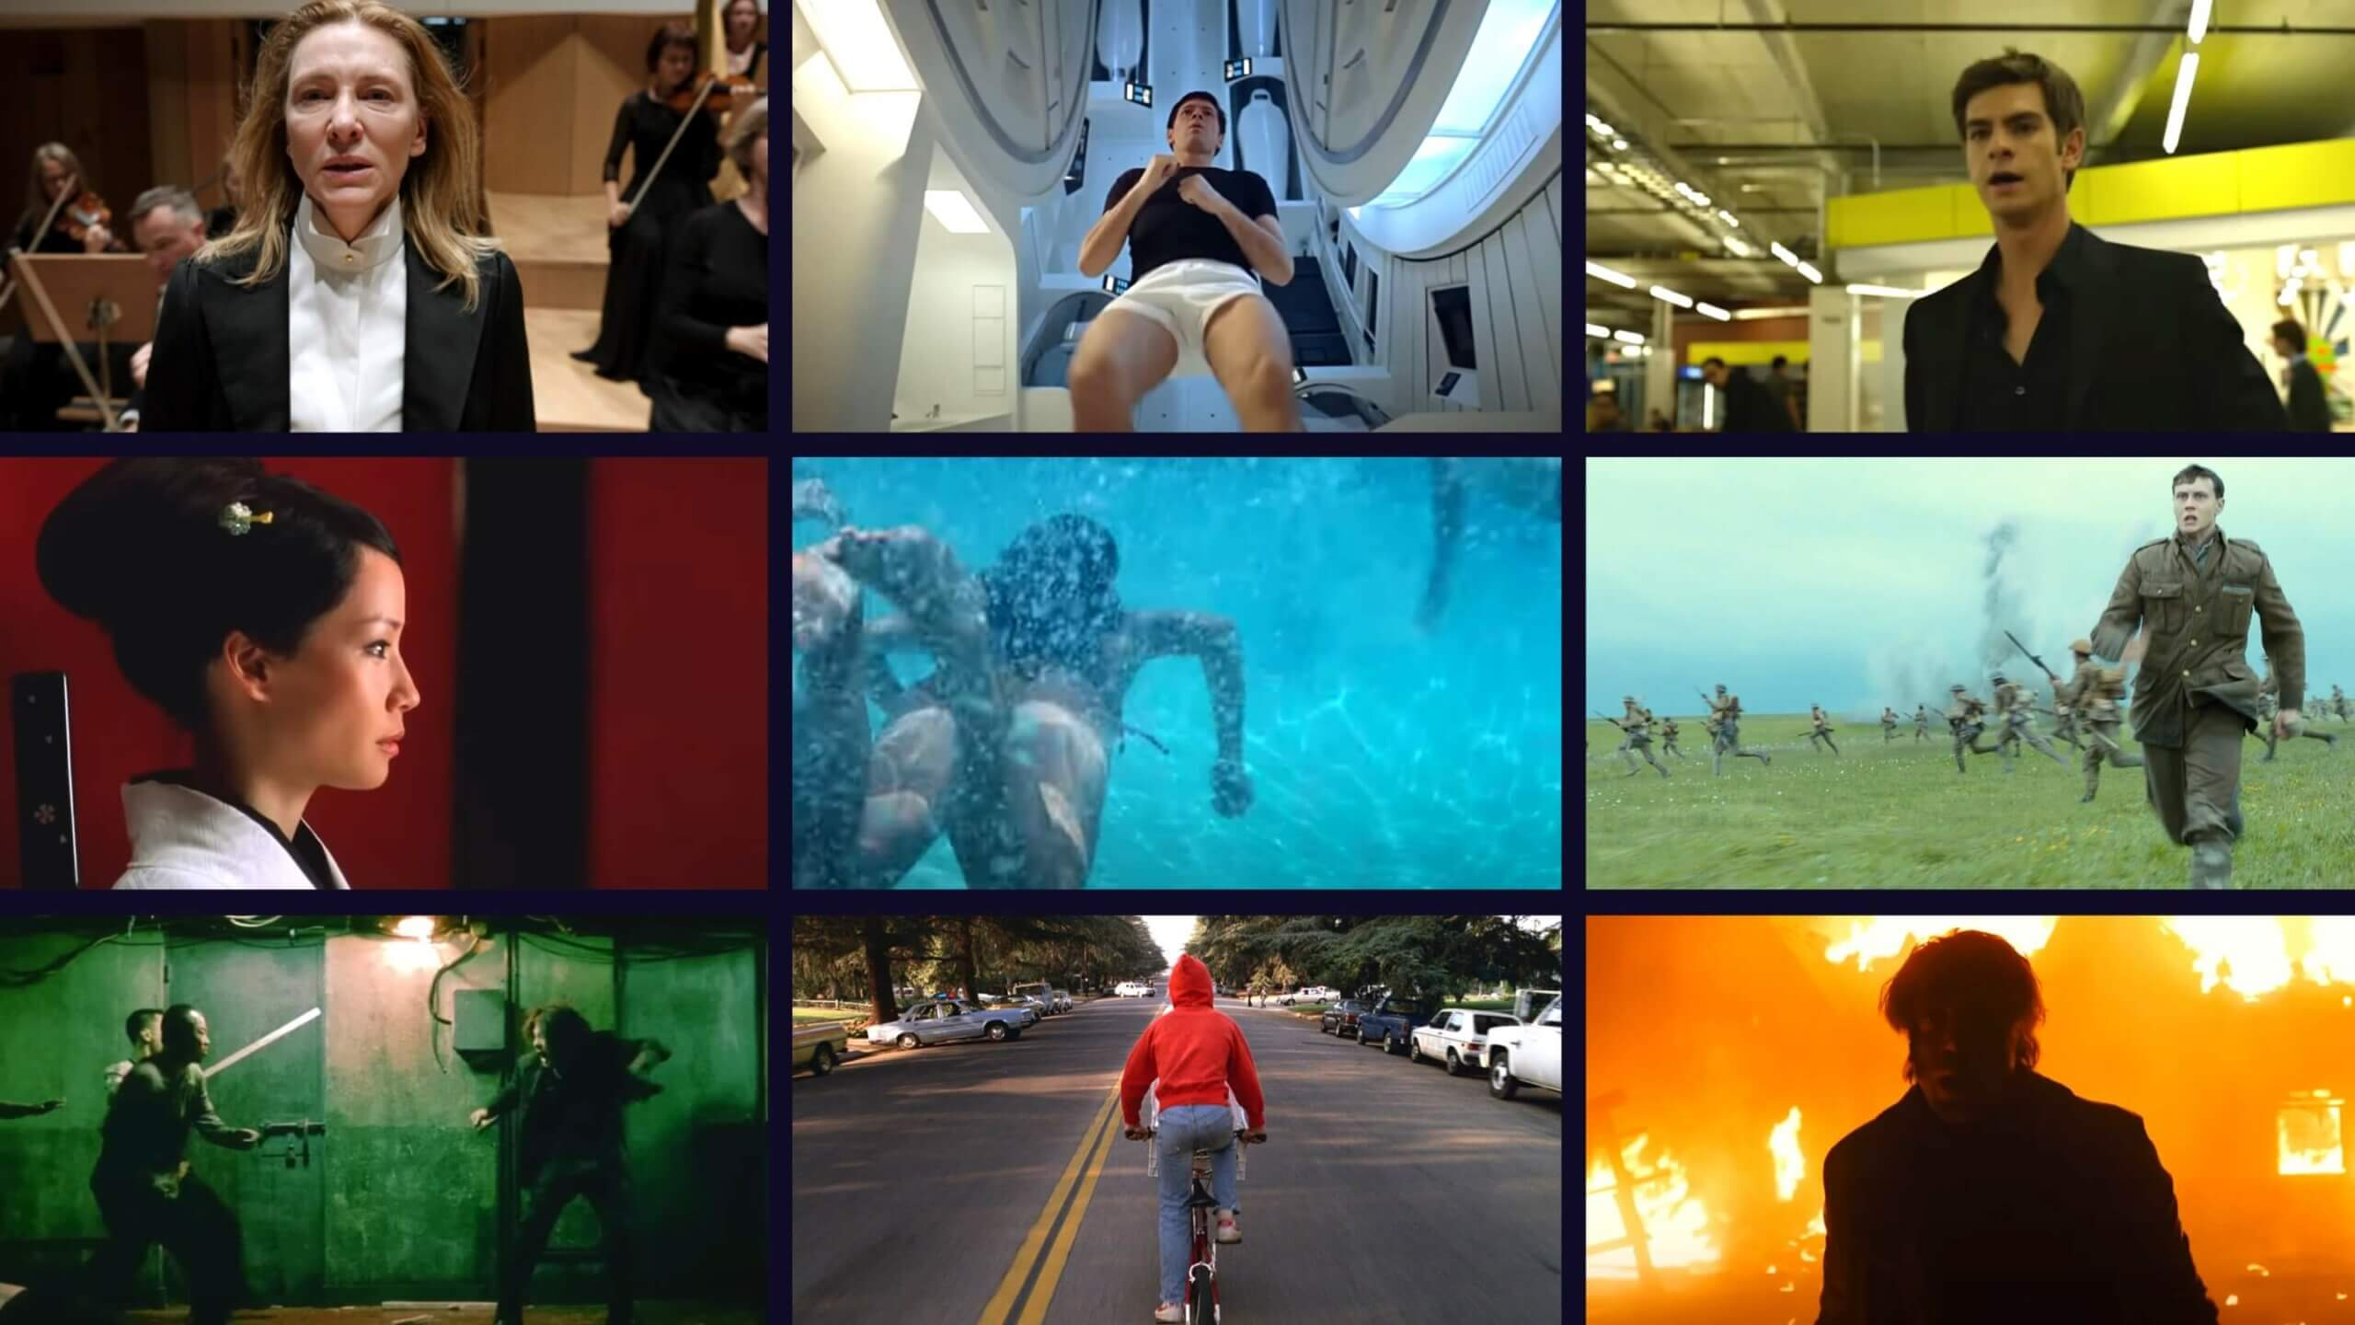

Slide 9
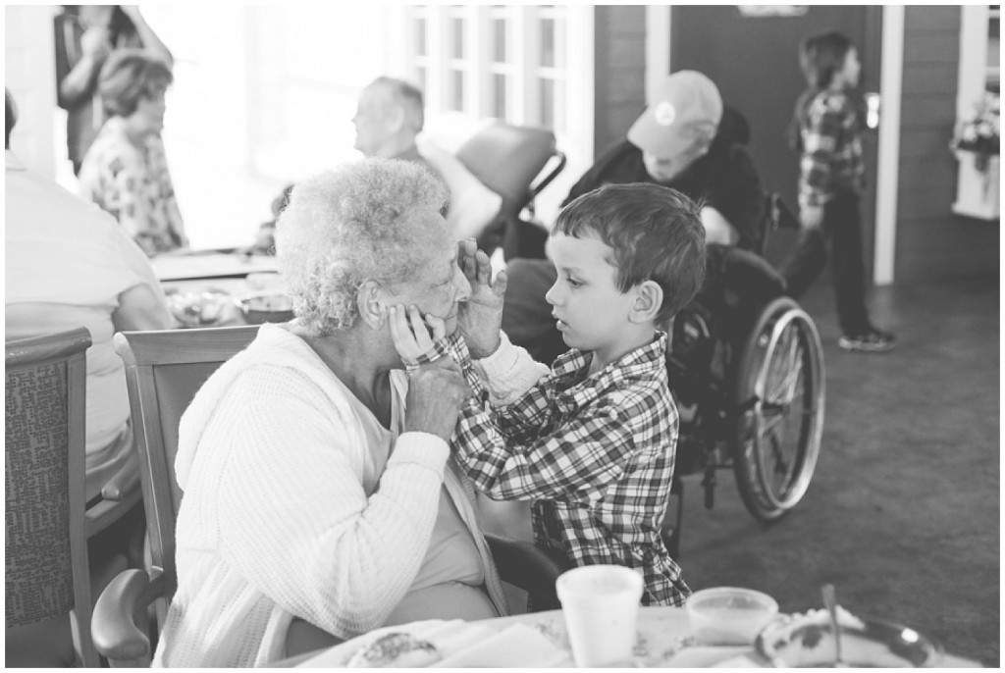
Look at the two photographs to the left.
What is the difference in photography styles between the two photos? What is the photographer’s attitude towards his or her art?

Slide 10
Formative v. Realistic
Formative –artists would adjust light, add props and objects, and try to influence their story. They considered it a focus on the artistic. (Edison’s The Kiss / Boxing Cats)
Realistic –Belief that art is meant to be unadulterated and unedited. This meant documenting exactly what was seen. The only intrusive aspect to the scene is the addition of a camera. (Lumiere’s actualites)

Slide 11
To Do List for 08.18.16
Happy Accidents, Melies, “Trick Films”, avant-garde
Narrative fiction, documentary, experimental film

Slide 12
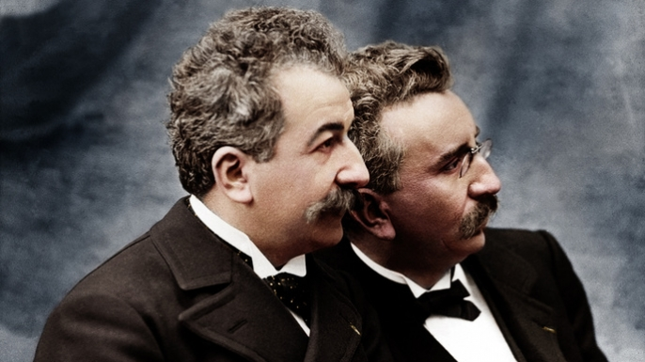
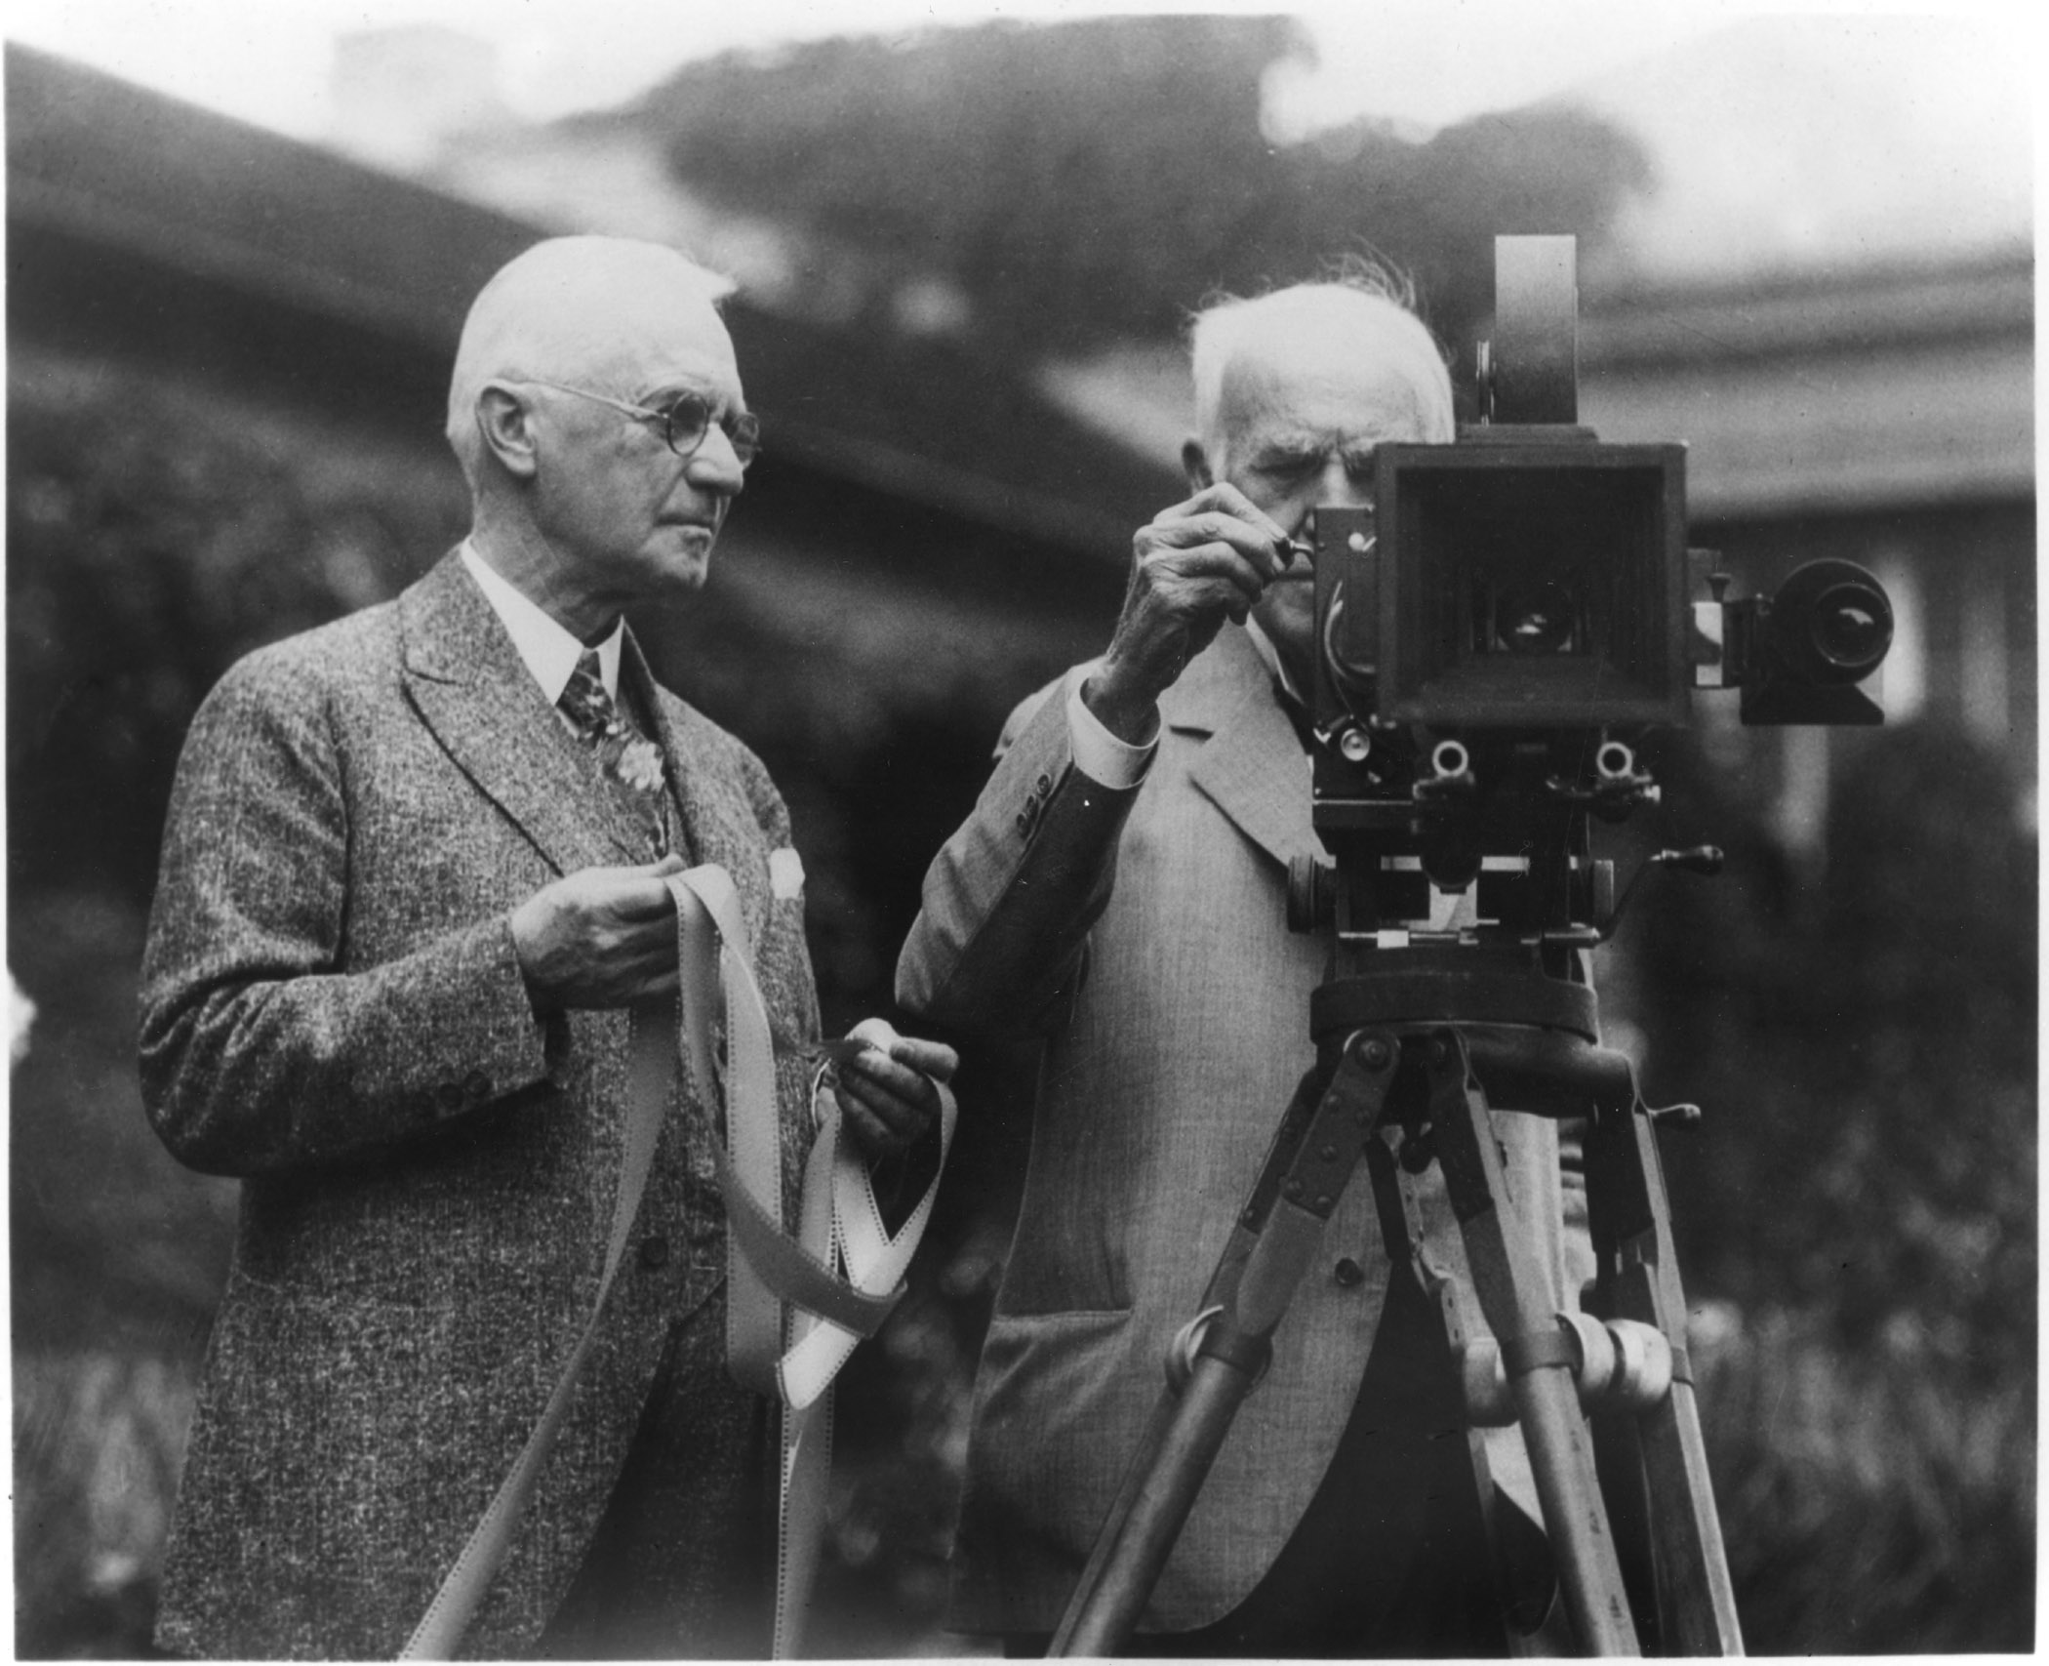
The “realistic” style actually created more of an illusion
Because reality moves in a three dimensional space, many of his early films gave the illusion of three dimensional properties, often terrifying his audience.
Arrival of Train
The “formative” style was based on stage performance.
Because staging is traditionally done in a horizontal fashion, many of the films lacked depth.
Ironically, Edison was looking at the novelty of film, but failed to capture the images that would draw audiences in.
His films were still extremely successful.

Slide 13
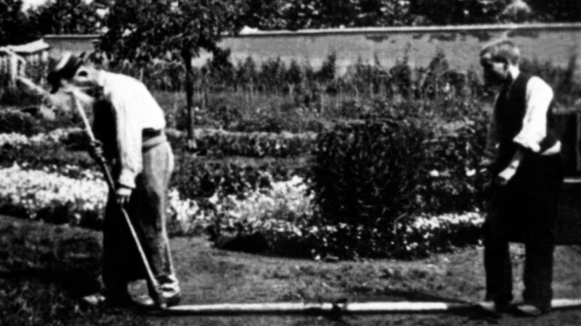
L’Arroseur arrose
The first fusion of the two styles (Staging, depth, and naturalism)
Followed by A Game of Cards, giving a staging element to filming

Slide 14
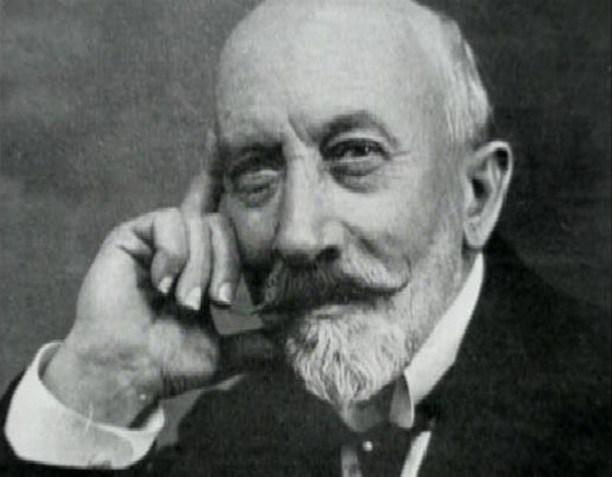
GEORGE MELIES

Slide 15
TERMS TO KNOW:
Auteur: More than a director for hire. This often is a director who has a specific art style or quality that is repeated through films. To oversimplify, this is someone who often does it for the artistic merit.
Motif: An image or idea that keeps popping up in film. Example: In The Departed, an “X” can be seen every time someone is about to die.

Slide 16
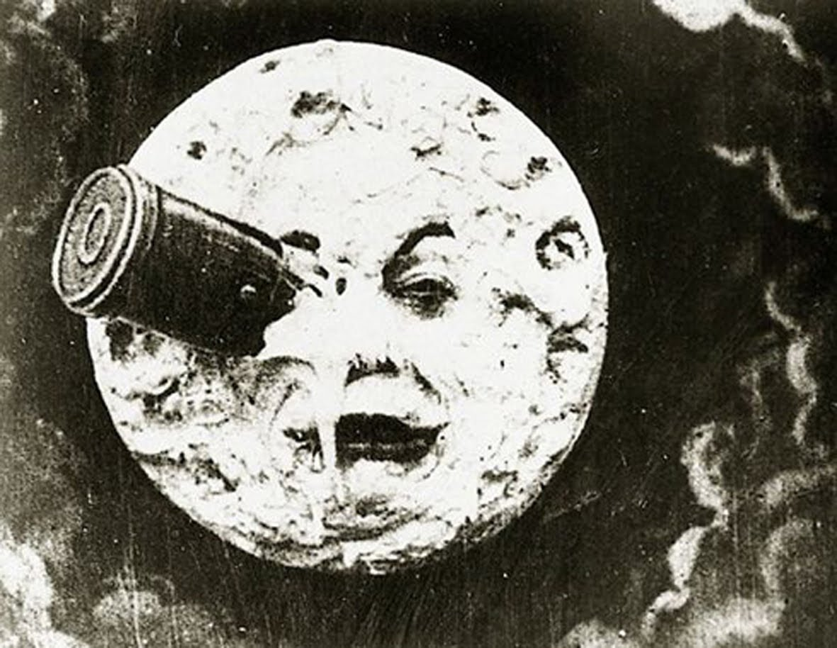
Define and give examples of:
-Narrative Fiction
-Documentary
-Experimental

Slide 17
To Do List
Discuss Narrative Fiction, Documentary, and Experimental Film
Edwin S. Porter: inventor of the scene
The first American film
The Life of a Fireman, Uncle Tom’s Cabin, The Great Train Robbery
Alice Guy / The Cabbage Fairy
Racism and Sexism in early film
HOMEWORK: Read pp. 9-20 + Notes

Slide 18
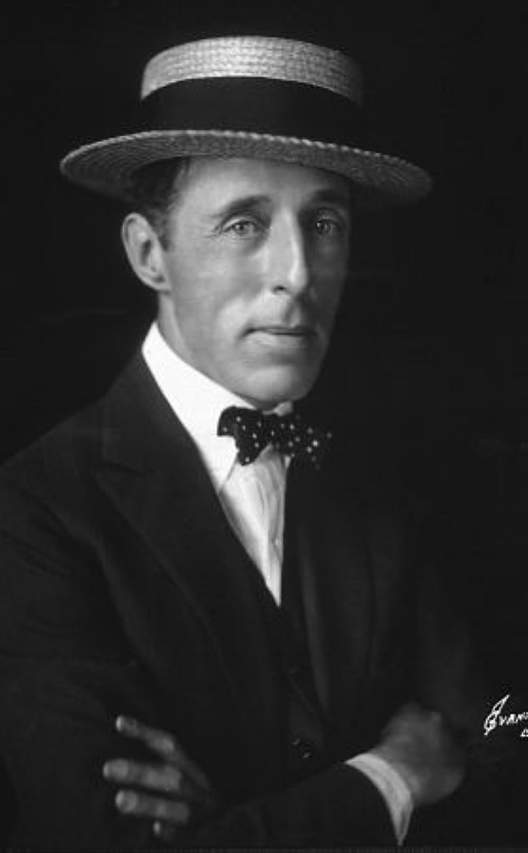
D.W. Griffith
Director of Birth of a Nation; Intolerance
Made the first real blockbuster: Birth of a Nation
Birth of a Nation leads to second rise of the Ku Klux Klan
Angry at criticisms that he’s a racist; makes Intolerance
While Intolerance is impressive, if kind of pathetic, it bankrupts him.
Shifts into role at United Artists (covered in Unit 3)

